Slide 1
GASTROINTESTINAL TRACT MEDICINE

Slide 2
GASTROINTESTINAL TRACT

Slide 3
MOUTH
(I) Stomatitis
simple/catarrhal stomatitis
candidiasis/oral thrush/moniliosis
ulcerative stomatitis
Apthous ulcerations
Gangrenous stomatitis (cancrum oris)
(ii) Gingivitis
(iii) Glossitis

Slide 4
OESOPHAGUS
Acute aesophagitis
Chronic oesophagitis
Achalasia of cardia
Ca esophagus

Slide 5
(3) STOMACH
(i) Gastric
(A) Acute gastritis
(B) Chronic gastritis
(ii) Peptic ulcers disease
acute peptic ulcers
chronic peptic ulcers
-Gastric ulcers
-Duodenal ulcers
(iii) ca stomach

Slide 6
(4)SMALL INTESTINE
(i) Malabsorption syndrome
(ii) Coeliac disease
(iii)Crohn’s disease
(5) LARGE INTESTINE
(I) Ulcerative colitis
(ii) Colorectal carcinoma

Slide 7
(6) HEPATOBILIARY SYSTEM.
1. THE PANCREASE
(I) Acute pancreatitis
(ii) Chronic pancreatitis
2. THE GALL BLADDER
(I) Acute cholecystitis (ii) Chronic cholecystitis

Slide 8
3. THE LIVER
JAUNDICE
Hepatomegally
Viral Hepatitis
Hepatitis A
Hepatitis B
Liver cirrhosis
Liver failure (Hepatic insufficiency)
Portal Hypertension
Hepatoma (Hepatocellular carcinoma)
Secondary Tumours of the liver

Slide 9
7. ASCITES
8. PERITONITIS
(i) Acute peritonitis
(ii) Chronic peritonitis

Slide 10
GASTROINTESTINAL TRACT
Functions
1. Motility
I. Ingestion
ii. Mastication
iii.Deglutition
iv. Peristalsis
2. Secretion
Exocrine secretions
Endocrine secretion
3. Digestion
4. Absorption
5. Elimination
Defense mechanism
1. High cell turnover
2. Mucus production
3. Immunologic-walls of intestines are lined with antibodies that protect the mucosa against any bacterial invasion.

Slide 11
Common GIT symptoms

Slide 12
Dysphagia and odynophagia
Heartburn and reflux
Indigestion
Flatulence
Vomiting
Anorexia
Hiccups
Constipation
Diarrhoea
Alteration of bowel pattern
Abdominal pain
Abdominal distension
Weight loss, cachexia

Slide 13
Haematemesis
Rectal bleeding
Melaena
Jaundice
Itching
Finger clubbing
Leuconychia
Urinary symptoms

Slide 14
Clinical Methods
Examination of GIT/Per abdomen
Inspection
Auscultation
Palpation
Percussion

Slide 15
MOUTH
A. STOMATITIS
Definition
Inflammation of mm lining the mouth.
TYPES
1. Simple (catarrhal) stomatitis
-This occurs due to local causes such as intake of hot food or cigarette smoking
TX-Heal spontaneously

Slide 16
2. Candidiasis/oral thrush/moniliasis
This is a fungal infection caused by Candida Albicans.
Seen in:-
i. It normally affects babies
ii.It is commonly seen in AIDS patients
iii.Also seen among Elderly patients.
iv. Patients with chronic debilitating illness e.g. DM or malignancies
v. Seen in patients on immunosuppressive drugs e.g. steroids or cytotoxic drugs.
vi. Also seen in patients who are on prolonged antibiotic therapy.
vii. Patients with poor oral hygiene.

Slide 17
CF
1. White patches on
(a) Soft palate
(b) Hard palate
(c) Sides of the tongue
(d) Buccal mucosa
2. If the white patches are scratched a reddish base is left.

Slide 18
RX
Gentian violet mouth paint tds
Oral thrush is treated using nystatin or amphotericin suspensions or lozenges
Mycostatin oral drops
Daktarin oral gel
Advice the pt on good oral hygiene

Slide 19
3. Ulcerative stomatitis (Vincent’s infection)
These are ulcerations involving the oral mucosa
Causes/Epidemiology
The cause is unknown but fusiform bacilli and spirogettes have been implicated.
It is a secondary infection by staphylococci or streptococci.
Common among pts with poor oral hygiene and those that is malnourished.
Also associated with bleeding disorders e.g. leukaemia, agranulocytesis or purpura.
DM also predisposes a patient to Vincent’s infection.

Slide 20
CF
Ulcers having a ragged necrotic, edges, surrounded by erythematous margins.
Commonly sites include the gum, lips, palate, and the inner sites of the cheeks.
TX
-Metronidazole
-Antibiotics
-Good oral hygiene
-treat underlying cause.

Slide 21
4. Apthous ulcerations
Definition
This is a recurrent condition by multiple painful superficial ulcerations of the mouth.
Aetiology
Unknown
Pathology
The lesion starts as an indurated erythematous area followed by ulcerations centrally
.

Slide 22
TX
-Antibiotics
-Multivites
-Good oral hygiene
-Systematic steroids (such as 0.1% triamcinolone in Orabase) or choline salicylate (8.7%) gel.
-Rarely, patients with very severe, recurrent aphthous ulcers may need oral corticosteroids.
-Symptomatic relief is achieved using local anaesthetic mouthwashes.
-Healing occurs within 2-3 weeks.

Slide 23
5. Gangrenous stomatitis (cancrum oris)
This is rare.
Generally develop following acute febrile illness e.g. measles.
Other causes
1. Ill fitting dentures
2. Vit.deficiency e.g. folic, niacin, Riboflavin
3. Tuberculosis of the mouth
4. Syphilis

Slide 24
O/E
An ulcer develops inside the cheeks, which rapidly spreads.
Occasionally it may heal but frequently it further perforates the cheeks or spread to the tongue chin, jaw bone.
It is accompanied by severe constitutional signs e.g. fever
Fever
Rapid pulse
Toxic-very sick
Other features
Diarrhoea
Broncho pneumonia
-+/- Death may occur within 7-10 days from the onset of illness.
TX
Systematic antibiotics

Slide 25
Causes of oral ulceration
1. Aphthous
• Idiopathic
• Premenstrual
2. Infection
• Fungal, e.g. candidiasis
• Viral, e.g. herpes simplex
• Bacterial, including syphilis
3. Gastrointestinal diseases
• Crohn's disease
• Coeliac disease

Slide 26
4. Dermatological conditions
• Lichen planus
• Pemphigoid
• Pemphigus

Slide 27
5. Drugs
• Hypersensitivity, e.g. Stevens-Johnson syndrome
• Cytotoxic drugs
6. Systemic diseases
• Systemic lupus erythematosus
• Behçet's syndrome
7. Neoplasia
• Carcinoma
• Leukaemia
• Kaposi's sarcoma

Slide 28
Squamous carcinoma of the oral cavity is common world-wide and the incidence has increased by 19% since the mid-1990s in the UK.
The mortality rate is around 50%, largely as a result of late diagnosis.
Poor diet, alcohol excess and smoking or tobacco chewing are the main risk factors.

Slide 29
ORAL CANCER
In parts of Asia the disease is common among people who chew areca nuts wrapped in leaves of the betel plant ('betel nuts').
Oral cancer may present in many ways and a high index of suspicion is required.

Slide 30
Symptoms and signs of oral cancer
Solitary ulcer without precipitant, e.g. local trauma
Solitary white patch ('leukoplakia') which fails to wipe off
Solitary red patch
Fixed lump
Lip numbness in absence of trauma or infection
Trismus (painful/difficult mouth opening)
Cervical lymphadenopathy

Slide 31
Management
Patients with suspicious lesions should have all possible sources of local trauma or infection treated and be reviewed after 2 weeks.
If the lesion persists, biopsy is advisable.
Small cancers can be resected but extensive surgery with neck dissection to remove involved lymph nodes may be necessary.

Slide 32
Some patients can be treated with radical radiotherapy alone, and radiotherapy is sometimes also given after surgery to treat microscopic residual disease.
Some tumours may be amenable to photodynamic therapy (PDT), avoiding the need for surgery.

Slide 33
B. GINGIVITIS
Definition
This is inflammation of the gums. There are three
varieties:-
Marginal Gingivitis
General Gingivitis
Ulcerative Gingivitis
1. Marginal
Causes
-Use of a hard tooth brush
-Use of tooth picks
O/E
The gums are red and swollen at their margins.
2. General
-It may occur in scurvy
-It may follow severe illness e.g. measles
-It may also occur following ingestion of drugs e.g.
mercury.
-The entire gum is red, swollen, and bleeds on
pressure.

Slide 34
3. Ulcerative
-Is associated or occur due to infection with treponema pallidum or other pyogenic infections.
O/E
The gums are usually swoolen, painful have a foul smelling breath (halitosis).
Have loose teeth.
The infection may spread to the pharynx and tonsil.
Sloughing later.
TX
-Antibiotics
- Metronidazole
-Tabs vitamin C 50mg tds x 10/7
-Advice to use soft tooth brush.
-Good oral hygiene.

Slide 35
3. GLOSSITIS
This is inflammation of the tongue.
Causes
(A) local
1. Infection of the mouth.
2. Mechanical trauma e.g.
i. Ill fitting dentures
ii. Repeating biting of the tongue during convulsions
3. Primary irritations e.g.
Alcohol
Cigarette
Hot foods
(B)Systemic
1. Avitaminosis-vit Deficiency esp. vitamin B
2. Anaemias-iron deficiency anaemia
3. Skin disorders e.g.-Linchen planus
-Erythema maltiforme

Slide 36
CF
1. Pain
2. Mastication, taking or swallowing may be painful.
3. Painful ulcers involving the tongue
4. Whitish patches involving the tongue
5. Fever
O/E
1. Swollen red tongue
2. enlarged cervical and sublingual LN
TX
-Analgesics
-Antibiotics
-Treat any systemic cause
-Advice the pt to avoid taking any strong irritants.

Slide 37
Parotitis
Parotitis is due to viral or bacterial infection.
Mumps causes a self-limiting acute parotitis.
Bacterial parotitis usually occurs as a complication of major surgery.
It is a consequence of dehydration and poor oral hygiene, and can be avoided by good post-operative care.

Slide 38
Patients present with painful parotid swelling and this can be complicated by abscess formation.
Broad-spectrum antibiotics are required, whilst surgical drainage is necessary for abscesses.

Slide 39
Causes of salivary gland swelling (DDX)
Infection
Mumps
Bacterial (post-operative)
Calculi
Sjögren's syndrome
Sarcoidosis

Slide 40
Tumours
Benign: pleomorphic adenoma (95% of cases)
Intermediate: mucoepidermoid tumour
Malignant: carcinoma

Slide 41
Oral health in old age
Dry mouth: affects around 40% of healthy older people.
Gustatory and olfactory sensation: declines and chewing power is diminished.
Salivation: baseline salivary flow falls but stimulated salivation is unchanged.
Root caries and periodontal disease: common partly because oral hygiene deteriorates with increasing frailty.
Bacteraemia and septicaemia: may complicate Gram-negative anaerobic infection in the periodontal pockets of the very frail.

Slide 42
OESOPHAGUS

Slide 43
GASTROESOPHAGEAL REFLUX DISEASE (GERD)
Gastroesophageal reflux disease (GERD) is one of the most common disorders encountered by internists, affecting up to 1 out of every 5 people in the United States.
It is characterized by the clinical symptoms of gastroesophageal reflux (GER) or histopathological changes caused by reflux of gastric secretions into the esophagus.

Slide 44
In addition to heartburn, the cardinal symptom of GERD, the disease can result in severe complications, including esophageal strictures and adenocarcinoma.

Slide 45
Etiology and Pathophysiology
GERD develops as a result of dysfunction of the processes responsible for preventing GER and clearing refluxed secretions from the esophagus.
Normally, tonic contraction of the lower esophageal sphincter (LES), as well as diaphragmatic crural contraction, helps protect the distal esophagus from GER.

Slide 46
When reflux does occur, esophageal peristalsis clears most of the gastric contents, preventing prolonged exposure of the esophageal mucosa to acidic secretions.
Any residual gastric acids are neutralized by alkaline saliva and bicarbonate secreted from submucosal glands.

Slide 47
Gastroesophageal reflux occurs regularly even in healthy people, but GERD develops when there is an imbalance between the damaging effects of refluxed material and the ability of the esophagus to withstand and clear it.
GERD occurs when the antireflux mechanisms fail, and thus gastric contents make contacts with lower esophageal sphincter.

Slide 48
Gastroesophageal reflux can occur through the following mechanisms.
The primary mechanism of reflux in both normal individuals and those with GERD is transient lower esophageal sphincter relaxation.
Another cause of reflux episodes is sudden elevations in intra-abdominal pressure.
In the setting of a hiatal hernia, the contribution of diaphragmatic crural contraction to distal esophageal closure is lost.

Slide 49
A less common cause of GER is inappropriately low basal LES pressures that do not exceed intragastric pressures. Also known as hypotensive LES, this condition is caused by dysfunction of the smooth muscle within the LES.
Hypotensive LES can occur in scleroderma.

Slide 50
A variety of clinical conditions and medications can further predispose to GER.
In pregnancy, Obesity- reflux is secondary to elevated intra-abdominal pressure and progesterone-induced lowering of LES pressure.
Fatty meals, coffee, chocolate, alcohol, and smoking can lower the LES pressure and delay gastric emptying. Also gastric outlet obstruction and Gastroparesis due to DM

Slide 51
Medications, such as calcium channel blockers, NSAIDS and anticholinergics, also lower the LES pressure.
Furthermore, reflux esophagitis has been associated with eradication of Helicobacter pylori in patients with peptic ulcer disease.
Abnormality of delayed oesophageal clearance e.g. scleroderma, anticholinergic drugs and Sjogrens syndrome.

Slide 52
Summary of Factors associated with gastrooesophageal reflux
Pregnancy, obesity
Fat, chocolate, coffee or alcohol ingestion
Large meals
Cigarette smoking
Drugs – antimuscarinic, calcium-channel blockers, nitrates, NSAIDS, anticholinergic
Systemic sclerosis, scleroderma, Pjogrens syndrome
After treatment for achalasia, H.Pylori
Hiatus hernia, DM e.t.c

Slide 53
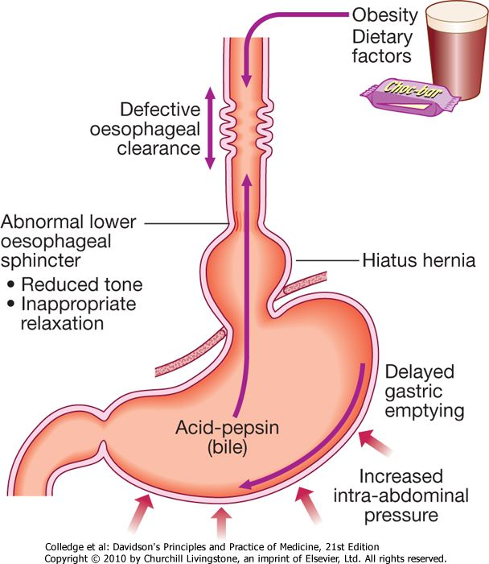
Factors associated with the development of gastro-oesophageal reflux disease

Slide 54
Clinical Features
Most patients with GERD report frequent heartburn that can be provoked or increased by laying down, bending forward, or exercising.
In addition, by the time of presentation to a physician, many patients report effectively self-treating these symptoms with over-the-counter antacids or acid- suppressing medications.
However, even in those with significant reflux-induced complications, heartburn may be absent and a variety of other symptoms present.

Slide 55
In some patients, esophageal acidification leads to hypersalivation (water brash), whereas others report chest pain.
Dysphagia may be a presenting symptom and is usually due to peptic esophageal stricture, although esophagitis-induced dysmotility and decreased esophageal compliance may also contribute.

Slide 56
Gastroesophageal reflux with regurgitation can lead to sour brash (sour taste due to regurgitation of gastric secretions into the oropharynx), chronic cough, pharyngitis, laryngitis, sinusitis, dental caries, and worsening of asthma.

Slide 57
Pain with swallowing/sore throat (odynophagia)
Nausea
Chest pain
Chocking at night – because reflux fluid irritate the larynx
History of weight gain

Slide 58
Oesophageal syndrome - present with;
Hoarseness of voice
Chronic cough
Asthma (Reflux induced asthma)
Laryngeal strictures
Laryngeal metaplasia – that may lead to cancer

Slide 59
Diagnosis
In most cases, a thorough history is sufficient to make a diagnosis.
Empiric acid suppressive therapy is not only indicated for treatment but can also confirm the diagnosis by eliminating symptoms.

Slide 60
Diagnostic testing for GERD is typically reserved for patients with atypical symptoms or to detect complications of the disease.
In these patients, barium swallow can demonstrate gross structural abnormalities (i.e. strictures) and esophageal motility disorders but is too insensitive to detect esophagitis.

Slide 61
Endoscopy is the most sensitive diagnostic test for detection of reflux esophagitis but is often normal in patients with GERD.
It should be reserved for refractory cases, dysphagia, odynophagia, weight loss, anemia, gastrointestinal hemorrhage, and suspicion of Barrett's esophagus.
For patients with normal endoscopy but persistent symptoms despite acid suppression therapy, correlation of the patient's symptoms with objective evidence of GER can help determine if GERD is truly the cause.

Slide 62
Ambulatory esophageal pH monitoring can be used for this purpose and utilizes a transnasal esophageal probe to monitor pH continuously for 24 hours.
Several parameters are measured, but the most important are the percentage of time with a pH <4.0 and the temporal relation between GER symptoms and an acidic esophageal pH.
In addition to confirming the diagnosis of GERD, this test can help determine the efficacy of acid-suppressing treatments.

Slide 63
Summary of investigations
Good history
Empiric acid suppressive therapy
Barium swallow
Endoscopy
Ambulatory esophageal pH monitoring

Slide 64
Management
The initial treatment of GERD depends on the severity of the patient's symptoms and endoscopic evidence of esophagitis.
For patients with mild to moderate symptoms and no evidence of complications of GERD, lifestyle modifications with antacids as needed is an appropriate first step.

Slide 65
Lifestyle modifications include;
Weight reduction if they are obese
Ceasation of smoking
Avoid dietery substances that provoke symptoms e.g.↓ fat, ↓↓sugar, ↑proteins
Eat 2-3 hours before bed time
Advice on small frequent meals
Avoid food that precipitate acid production e.g. lentils, sukuma wiki, alcohol, chocolate
Elevate the head on bed by 30º

Slide 66
Endoscopy is indicated to evaluate for esophagitis and exclude causes other than GERD in patients with severe symptoms or other evidence of complicated disease.
If oesophagitis is detected, initial therapy should include lifestyle changes and proton pump inhibitor (PPI) therapy because histamine-2 (H₂) receptor antagonists are usually inadequate for healing esophageal erosions.

Slide 67
If no esophagitis is found on endoscopy and symptoms persist despite PPI therapy, ambulatory esophageal pH monitoring is useful for confirming a causal relationship between GER and the patient's symptoms.
Patients with esophagitis may be treated with PPIs for 8 to 12 weeks and then started on an H₂ blocker for long-term therapy. However, many patients develop recurrent symptoms and require continuous treatment with PPIs.

Slide 68
For patients with refractory GERD, antireflux surgery (fundoplication) or endoscopic antireflux procedures can be utilized.
Surgery – involves antireflux surgery i.e. fundoplication

Slide 69
Indications for surgery
Persistent or recurrent antireflux symptoms despite medical therapy
Severe oesophagitis on endoscopy
Benign stricture
Barret oesophagus but not cancerous
Recurrent respiratory tract symptoms or LRT symptoms.

Slide 70
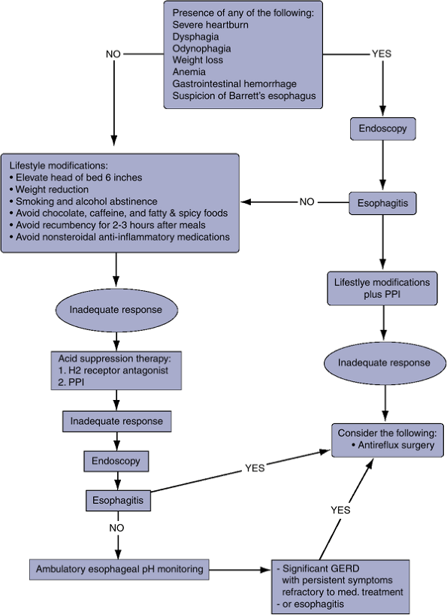

Slide 71
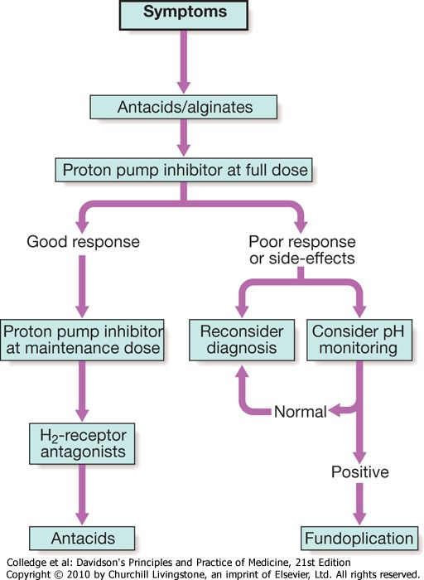
Treatment of gastro-oesophageal reflux disease: a 'step-down' approach.

Slide 72
Common complications of gastroesophageal reflux disease
Esophageal ulcers
Esophagitis
Esophageal strictures
Anaemia – due chronic blood loss
Gastric volvulus
Recurrent pneumonia
Barrett's esophagus (precancerous lesion)

Slide 73
DDX
These conditions must be distinguished from esophageal webs, motility disorders, and malignant strictures.
oesophageal strictures and ulcers
Barrett's oesophagus
Peptic ulcer disease
Angina pectoris
Acute pancreatitis
Acute cholecystitis
Radiation oesophagitis

Slide 74
NOTE ABOUT BARRETT’S
Barrett's esophagus develops asymptomatically and is not reversed by medical therapy for GERD.
It is found more commonly in men, whites, tobacco users, and those with longstanding (>5 years) GERD.
Representing one of the most serious sequelae of long-standing GERD, Barrett's esophagus is characterized by replacement of the native esophageal squamous epithelium with an abnormal columnar epithelium called specialized intestinal metaplasia.

Slide 75
Although more resistant to the effects of acid reflux, the abnormal mucosa is prone to dysplasia and adenocarcinoma.
The risk of esophageal malignancy is 30 to 50 times that of the general population and requires close endoscopic surveillance in an interval dictated by the degree of dysplasia.
Esophagectomy is recommended for high-grade dysplasia, although photodynamic therapy (PDT) has been suggested as an option for poor operative candidates.

Slide 76
ACUTE OESOPHAGITIS
This is Acute inflammation of the oesophagus.
A etiology
1. Ingestion of chemical irritants e.g. Acid, alkaline, Organophosphate.
-The intake may be accidental, suicidal or poisoning.
2. Reflux of Gastric Acid
3. Impacted Fb
4. Repeated vomiting
5. Infections, moniliasis, diphtheria

Slide 77
CF
1. Has a causative condition e.g. ingestion of corrosive agent +/-
2. Pain on swallowing i.e. odynophagia
3. Retrosternal pain
4. Haematemesis
5. Fever
TX
IVF
Analgesics
Antacids
Antibiotics +/-
Course
1. Rapid recovery
2. Perforation of the oesophagus –Mediastinitis with subsequent death
3. Oesophageal scarring with stricture formation.

Slide 78
CHRONIC OESOPHAGITIS
This is chronic inflammation of the oesophagus.
Causes
Prolonged alcohol intake
Chronic vomiting
Repeated passage of N/G tube.
Achalasia of cardia
Hiatus hernia
Pathology
Following chronic inflammation→ ulcer formation and scarring with stricture formation→Narrowing of the oesophagus.

Slide 79
CF
Regurgitation of bitter fluids with retrosternal
pain.
Repeated haematemesis
Other symptoms are those of the underlying
cause.
O/E
1. Pale
2. Other signs are those of underlying cause.
TX
Avoid irritating factors-stop Alcohol
Advice to take soft foods
Provide antacids
Treat any complication
Pass stents to prevent stenosis.

Slide 80
ACHALASIA OF CARDIA (CARDIOSPASMS OR APERISTASIS)
This is a chronic disorder characterized by weak and an coordinated peristalsis in esophagus and failure of the lower oesphageal sphincter to completely relax during swallowing.
Aetiology is Unknown

Slide 81
However there is evidence that the degeneration of the Auerbachs plexus causes loss of neurologic control of the oesophagus.

Slide 82
Pathophysiology
Achalasia is characterised by:
a hypertonic lower oesophageal sphincter which fails to relax in response to the swallowing wave
failure of propagated oesophageal contraction, leading to progressive dilatation of the gullet.

Slide 83
Defective release of nitric oxide by inhibitory neurons in the lower oesophageal sphincter has been reported, and there is degeneration of ganglion cells within the sphincter and the body of the oesophagus.
Loss of the dorsal vagal nuclei within the brain stem can be demonstrated in later stages.
Infection with Trypanosoma cruzi in Chagas disease causes a syndrome that is clinically indistinguishable from achalasia.

Slide 84
Fluid and food accumulate in the oesophagus (lower portion).
It does not get into the stomach, unless there is a high HP.
The body of the oesophagus losses tone as food or fluid accumulate and becomes dilated.
The result of food accumulation is that some of the food is aspirated into the lungs-pneumonia.
Also there is damage to the wall of the oesophagus inflammation.
↓
Erosion of the mucosa
↓
There could be malignant change.

Slide 85
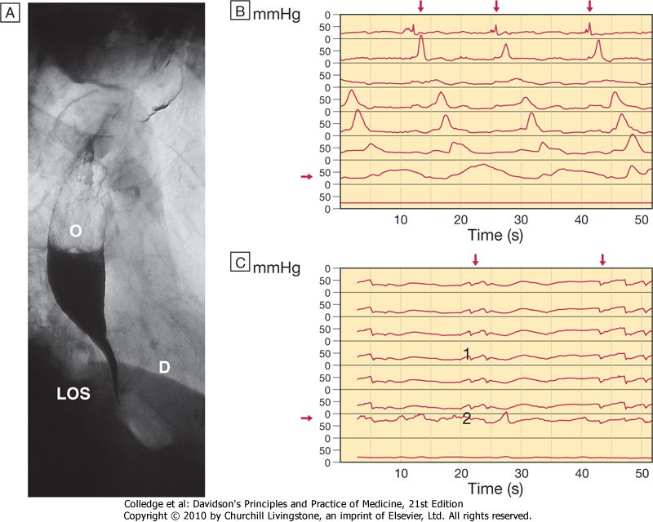
X-ray showing a dilated, barium-filled oesophagus (O) with fluid level and distal tapering, and a closed lower oesophageal sphincter (LOS). (D = diaphragm)
Normal oesophageal manometry showing propagated swallows and normal LOS pressure with relaxation on swallowing.
Manometry in achalasia showing non-propagated, ineffective contractions (1) and raised LOS pressure with failure of relaxation on swallowing

Slide 87
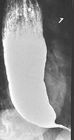
Funnel like appearance
or
2. Birds beak appearance

Slide 88
CF
The onset is insidious
It affects adults who are 30 years.
Dysphasia for both solids and liquid foods.
Later the pt has regurgitation
H/o feeling relieved by taking a drink after a meal.
Substernal pain after feeds.
Weight loss-later
O/E
wasted if the disease is advanced
Features of pneumonia or lung abscess

Slide 89
DX
Made on basis of :-
1. Typical history e.g.
Dysphasia
Weight loss
Substernal pain
2. CXR
Shows dilated oesphageal outline with a fluid level behind the heart shadow.
3. Barium swallow
Shows dilated oesophageal body with a narrowed enlongoted lower zone-funnel like appearance.
4. Oesophagoscopy
-Shows dilated oesophagus
-Also shows oesophagitis.
-When this is done Biopsy is taken.
5. Biopsy

Slide 90
DDX
1. Oesophageal stricture
2. Ca oesophaus
TX
1. Conservative TX
(a)Pass stents down the oesophagus to dilate the lower aesophagus sphincters.
(b)Surgical incision. Heller’s myotomy
-An incision is done through the muscle layer at the LOS.The contracted part is out; the mucosa is pouched out-to prevent edges healing together.
2. Treat the complications
3. Other measures
(a) Advice the pt to take soft well chewed food
(b) Avoid the pt to sleep with head elevated to avoid aspiration of oesophagus contents.

Slide 91
HIATUS HERNIA

Slide 92
Important features of hiatus hernia
Herniation of the stomach through the diaphragm into the chest
Occurs in 30% of the population over the age of 50 years
Often asymptomatic
Heartburn and regurgitation can occur
Gastric volvulus may complicate large para-oesophageal hernias

Slide 93
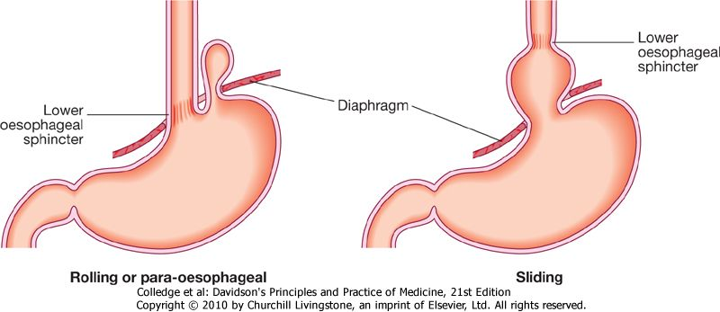
Types of hiatus hernia.

Slide 94
Causes of oesophageal stricture
Gastro-oesophageal reflux disease
Webs and rings
Carcinoma of the oesophagus or cardia
Eosinophilic oesophagitis
Extrinsic compression from bronchial carcinoma
Corrosive ingestion
Post-operative scarring following oesophageal resection
Post-radiotherapy
Following long-term nasogastric intubation

Slide 95
Tumours of the oesophagus

Slide 96
Benign tumours
Are very rare
The most common is a gastrointestinal stromal tumour (GIST).
This is usually asymptomatic but may cause bleeding or dysphagia.
Benign tumours comprise less than 1-2% of all tumours of oesophagus.
These tumours could be anywhere in the oesophagus, inside, on the walls, pedunculated or outside.

Slide 97
benign tumours of the oesophagus include;
Leiomyoma
Fibroma
Oesophageal cycts
Polyps
Lipoma
Papilloma
Haemangioma

Slide 98
Most occur in the middle and lower 1/3 of oesophagus.
Most are asymptomatic but some may cause;
Obstruction
Bleeding because of mucosal ulceration
Sense of fullness
Bronchial compression
Some are seen on routine bronchography

Slide 99
Diagnosis is through barium swallow –smooth filling defect in the oesophagus
NB. Any rough filling defects indicate malignancy.
Oesophagoscopy confirms diagnosis

Slide 100
CA OESOPHAGUS

Slide 101
CA OESOPHAGUS
This is a common malignancy.
High prevalence – Nyanza
Other parts - Not exceptional.
Aetiology
Unknown
PF
Ages >50 years
M>F

Slide 102
Smoking - Heavy cigarette smoking
Alcohol excess
Chewing betel nuts or tobacco
Coeliac disease
Achalasia of the oesophagus - Pts with achalasia of cardia or hiatus hernia are more prone to Ca oesophagus
Post-cricoid web
Post-caustic stricture
Tylosis (familial hyperkeratosis of palms and soles)

Slide 103
Pathology
Two types
Squamous cell carcinoma.
Adenocarcinoma.
Squanmous cell carcinoma is more common accounting for 90%.
It affects three parts
Upper 1/3-17%
Mid 1/3-50%
Lower 1/3- 33%
The commonest is mid 1/3.
When the malignancy develops, ulcer forms which extends circumferentially and longitudinally.
In advanced stages Ca oesophagus, stenosis will occur.
It may spread:-
Locally
Lymphatic

Slide 104
CF
1. Progressive dysphagia
2. There is first difficulty to swallow solid, followed by semi solids, then liquids.
3. Substernal pain- Dull and constant
4. Discomfort at site of obstruction
5. Regurgitation of food which may be blood stained.
6. Features of pneumonia
7. Weight loss (cachexia)
8. Features of metastatic spread. To:-
Trachea-Bronchi - cough
Bone - Bone pain
Liver - Jaundice hepatomagaly
Pericardium – Pericarditic Effusion
Recurrent laryngeal Nerve
- Hoarseness of voice

Slide 105
O/E
Early stages, No physical signs.
Wasted
Pale
Supraclavicular lymphadenopathy
DX / Investigations
Good Hx
Ba swallow
- Shows circumferential irregular
- Narrowing of the oesophagus.
- Early stages-shouldering effect may be seen.
- Later stages-rat tail appearance.
CXR
Oesophagus - shows appearance and sites of the tumour.
Biopsy – Histology - show type of m/g

Slide 106
DDX
Achalasia of cardia
Oesophageal stricture
MX
Palliative
Good nutrition care
Correct any anaemia
Analgesics
Feeding tube to by pass the tumour, for nourishment. This tube is called Celestine tube.
Surgery
1. Oesophagogastrectomy
This is done if the tumour involves the lower 1/3 without any metastasis.
2. Gastrostomy
Open the anterior wall of the abdomen, then the stomach and pass in a tube for feeding.
3. Radiotherapy
Radiations are passed to the site of tumour.
Is done if the tumour affects the upper 1/3.
Prognosis
The prognosis is poor, patients die within 5 years.

Slide 107
Perforation of the oesophagus

Slide 108
Perforation of the oesophagus
The most common cause is endoscopic perforation complicating dilatation or intubation.
Malignant, corrosive or post-radiotherapy strictures are more likely to be perforated than peptic strictures.
A perforated peptic stricture is usually managed conservatively using broad-spectrum antibiotics and parenteral nutrition; most heal within days.

Slide 109
Malignant, caustic and radiotherapy stricture perforations require surgical resection or intubation.
Spontaneous oesophageal perforation ('Boerhaave's syndrome') results from forceful vomiting and retching.
Severe chest pain and shock occur as oesophago-gastric contents enter the mediastinum and thoracic cavity.

Slide 110
Subcutaneous emphysema, pleural effusions and pneumothorax develop.
The diagnosis is made using a water-soluble contrast swallow, but in difficult cases both CT and careful endoscopy (usually in an intubated patient) may be required.
Treatment is surgical.
Delay in diagnosis is a key factor in the high mortality associated with this condition.

Slide 111
Causes of dysphagia
A. Mechanical causes
Malignant stricture
Oesophageal cancer
Gastric cancer
Pharyngeal cancer
Benign strictures
Oesophageal web or ring
Peptic stricture

Slide 112
3. Extrinsic pressure
Lung cancer
Mediastinal lymph nodes
Retrostinal goitre
Aortic aneurysms
Left atrial enlargement
4. Pharyngeal pouch

Slide 113
Motility disorders
Achalasia
Diffuse oesophageal spasm
Systemic sclerosis
Myasthenia gravis
Bulbar palsy
Pseudobulbar palsy
Syringobulbia
Bulbar poliomyelitis
Chagas’ disease

Slide 114
Others
1. Oesophagitis
Infection (candidiasis, HVS)
GERD
2. Globus hystericus

Slide 115
STOMACH

Slide 116
Anatomy of the Stomach
Stomach is:
Roughly J Shaped at rest.
Size and Shape varies with :-
a) Volume of food or fluid it contains
b) Position of body
c) Phase of respiration
High and transverse in obese and short persons.
Elongated in thin persons.

Slide 117
Anatomy of the Stomach
Stomach has:-
Two surfaces : 1. Anterior 2. Posterior
Two Curvatures: 1.Greater 2. Lesser
Two Orifices: 1. Cardia 2. Pylorus

Slide 118
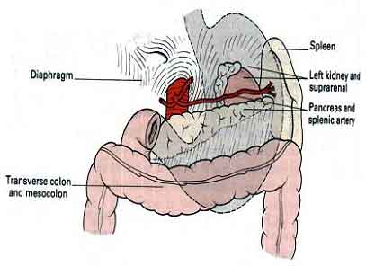
Stomach Bed:
Left crus and dome of diaphragm
Body of Pancreas
Splenic artery
Transverse mesocolon, left colic flexure
Part of left kidney, left suprarenal.
Coeliac plexus, ganglion and lymph nodes.

Slide 119
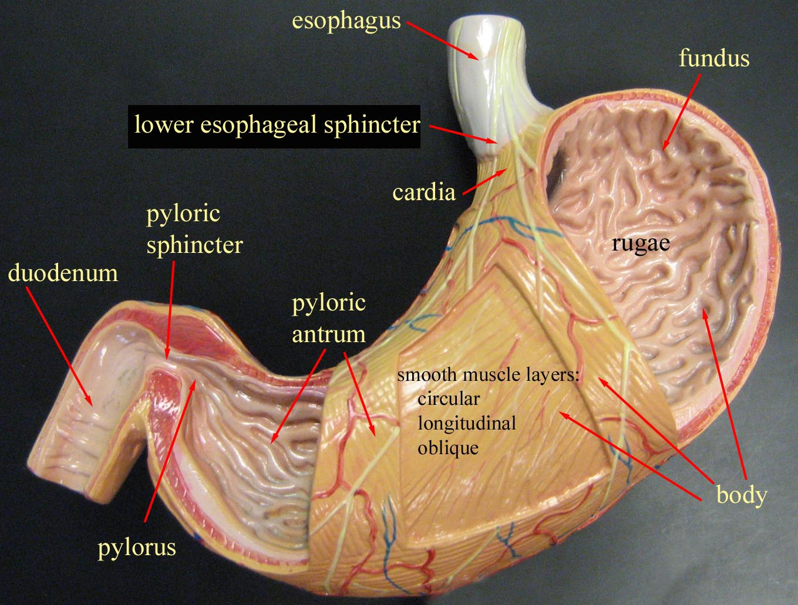
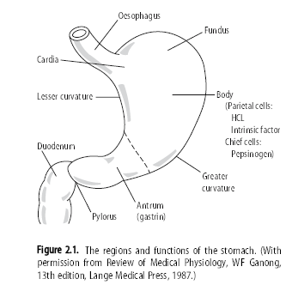
*Image via Bing

Slide 120
Arterial Supply of the Stomach
Left gastric artery
Right gastric artery
Left gastro-epiploic artery
Right gastro-epiploic artery
Short gastric arteries
Posterior gastric artery

Slide 122
Lymphatic Drainage of the Stomach
Area I:
The superior two-thirds of the stomach drain along the left and right gastric vessels to the aortic nodes.
Area II:
The right two-thirds of the inferior one-third of the stomach drain along the right gastro-epiploic vessels to the subpyloric nodes and then to the aortic nodes.
Area III:
The left one-third of the greater curvature of the stomach drains along the short gastric and splenic vessels lying in the gastrosplenic and lienorenal ligaments, then, via the suprapancreatic nodes, to the aortic group.

Slide 123
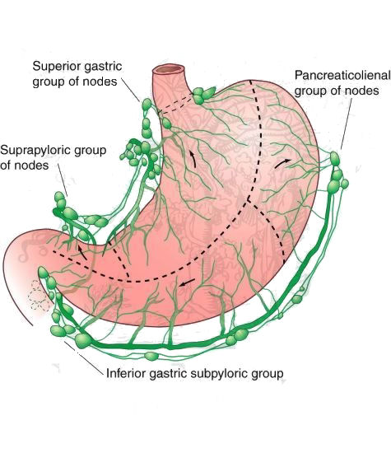

Slide 124
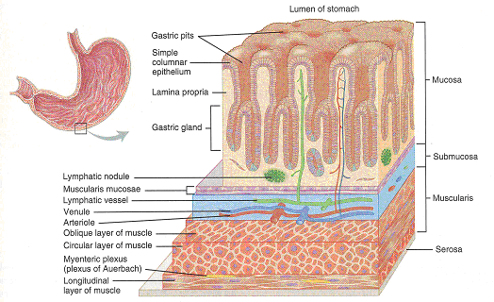
Acid production in the stomach is ONLY in the mid-BODY, and the proximal and distal ends secrete chiefly mucous to protect the esophagus and duodenum from the harsh acid.

Slide 125
Cells
MUCOUS: MUCUS, PEPSINOGEN II
CHIEF: PEPSINOGEN I, II
PARIETAL: ACID
ENTEROENDOCRINE: HISTAMINE, SOMATOSTATIN, ENDOTHELIN

Slide 126
Dyspepsia

Slide 127
Dyspepsia
Defn – Dyspepsia is a non specific group of symptoms related to upper GI tract.
A. Non specific symptoms
Epigastric pain e.g. related to hunger, eating specific foods or time of the day
May be associated with bloating ± fullness after meals
Heart burn (retrosternal pain with demonstrable acid reflux)
ALARMS – Anaemia (iron deficiency), Loss of weight, Anorexia, Recent onset of progressive symptoms, malaena or haematemesis, Swallowing difficulty.

Slide 128
B. Signs
Tender epigastrium (non-specific)
Any abdominal mass
Supraclavicular nodes ± hepatomegaly

Slide 129
Managing new dyspepsia
>55yrs or ALARMS
Do upper GI endoscopy
- Stop drugs causing dyspepsia, e.g. NSAIDS
- Life style changes
- Over the counter antacids, e.g. magnesium trisilicate 10mls 8hrly PO
- Review after 4 weeks
Test for H. Pylori
No further Action
YES
NO
IMPROVEMENT
NO IMPROVEMENT

Slide 130
If H. pylori test is positive, treat to eradicate H. Pylori , then review after 4 weeks. If the patient improves, no further treatment. If there is no improvement, do Urea Breath test (UBT), to confirm H. pylori eradication. If eradicated, consider upper GI endoscopy.
If H. Pylori test is negative, give PPI or H₂ blockers for 4 wks. If there is improvement no further action. If there no improvement, consider long term, low dose treatment and endoscopy.

Slide 131
Assignment
Read and make notes on;
DIARRHOEA
CONSTIPATION

Slide 132
GASTRITIS

Slide 133
GASTRITIS
Inflammation of Gastric mucosa.
May be Acute or chronic.

Slide 134
ACUTE GASTRITIS
This is quite common and usually is self limiting.
Causes
Excessive alcohol intake
Drugs-NSAIDS, caffaine, steroids, Aspirin, FeSo4, digitalis
Chemical irritants-e.g. acids, alkali, or organophosphate-taken accidentally or suicidal
Unsuitable diets e.g. food poisoning or inappropriate cooked food or very spicy foods.

Slide 135
Acute infections e.g. viral infections, influenza, CMV, Herpes simplex in HIV .
Multi-organ failure; Uraemia
Bile reflux, e.g. following gastric surgery – esp. distal gastrectomy.
Severe physiologic Stressful conditions e.g.
-Trauma
-Burns
-CNS trauma
-Chemotherapy
-Radiation

Slide 136
Ischemia and shock
Gastric irradiation or freezing
Mechanical trauma (e.g., nasogastric intubation)

Slide 137
Pathology
Due to inflammation, there is inflammatory reaction-oedematous and reddened mucosa with plenty of mucus.
There will be small spots of erosion in the mucosa and sometimes haemorrhage.
The degree varies with the cause.
Acute gastritis is often erosive and haemorrhagic.
Neutrophils are the predominant inflammatory cell in the superficial epithelium.

Slide 138
CF
Sudden epigastric pain
Anorexia
Nausea
Vomiting
Abdominal discomfort
Belching
Occasionally the vomitus is Blood stained or severe haematemisis or vomitus may contain food taken.
Thirst
Diarrhoea
H/O causative agent

Slide 139
O/E
If the condition is severe –looks quite sick
Dehydrated
Pale
Febrile-particularly in food poisoning. Otherwise temperature is always subnormal.
Tachycardia with a rapid feeble pulse because of Hypovolaemia.
P/A
Epigastric Tenderness

Slide 140
DX
Vomitus colour, smell, chemical analysis.
Gastroscopy.
Gastritis is a histological diagnosis, although it can sometimes be recognized at endoscopy.
DDX
Gastric ulcer
Assgn: LIST MORE DDX

Slide 141
Treatment
-Self limiting in most cases.
-If it is severe.
Admit
Observe V/S closely
IVF
Oral feeding till vomiting subsides.
Antispasmodic agents e.g. Buscopan
Acid suppression by use of; Antacids or PPI
Analgesics e.g. paracetamol
Antiemetic if vomiting e.g. metoclopramide
Poisoning - antidote
If chemical agent is not corrosive then Gastric lavage is done.

Slide 142
CHRONIC GATRITIS

Slide 143
CHRONIC GATRITIS
CAUSES
Unknown
Associated features
May follow Acute Gastritis
Associated cigarette smoking
Problems affecting the stomach e.g. Gastric ulcer, ca stomach, gastric polyps or duodeno gastric reflux.
Gastrointestinal disease e.g. crohn’s disease
Endocrine disorders e.g. pituitary or adrenal insufficiency.
Blood disorders e.g. iron deficiency anaemia

Slide 144
Autoimmune disease e.g. Addison’s disease, Thyroiditis, Pernicious anaemia.
Chronic infection by H. pylori
Postsurgical, especially following antrectomy with gastroenterostomy with reflux of bilious duodenal secretions
Infections – CMV, tuberculosis
Systemic disease. e.g. sarcoidosis, graft-versus-host disease.
Idiopathic, e.g. granulomatous gastritis

Slide 145
Motor and mechanical, including obstruction, bezoars (luminal concretions), and gastric atony.
Radiation
Granulomatous conditions (e.g., Crohn’s disease)
Miscellaneous - amyloidosis, graft-versus-host disease, uremia.

Slide 146
Pathology
Consist of Histological changes.
Chronic superficial Gastritis-The inner layer is of normal condition but the mucosa is infiltrated with inflammatory cells.
Chronic atrophic Gastritis-There is progressive irreversible atrophy of the Glandular cells, this leads to limited production of secretions. Therefore the mucosa becomes thin and the rugae flatten.
Gastric atrophy-The mucosa becomes thinner. All cells become atrophied.

Slide 147
CF
Most pts are asymptomatic but there may be vague symptoms e.g. constant mild anorexia and nausea.
Vomiting +/-
Sense of distension or pain after eating
Easy satiety
Dull diffuse epigastric discomfort or burning.
Severe abdominal pain may occasionally be there.
O/E
- Nothing +ve

Slide 148
DX
Ba meal-shows mucosal faults
Gastrascopy with Biopsy-this shows typical Histological changes.
TX
No known TX that can regenerate the atrophied cells.
Antacids
Treat associated cause.

Slide 149
SPECIAL FORMS OF GASTRITIS
Eosinophilic gastritis
Allergic gastroenteropathy
Lymphocytic gastritis
Granulomatous gastritis.
Graft-versus-Host Disease
Reactive gastropathy - Endoscopy - watermelon stomach

Slide 150
Ménétrier's disease
In this rare condition the gastric pits are elongated and tortuous, with replacement of the parietal and chief cells by mucus-secreting cells.
As a result, the mucosal folds of the body and fundus are greatly enlarged. Most patients are hypochlorhydric.
Whilst some patients have upper gastrointestinal symptoms, the majority present in middle or old age with protein-losing enteropathy due to exudation from the gastric mucosa.
Barium meal shows enlarged, nodular and coarse folds which are also seen at endoscopy, although biopsies may not be deep enough to show all the histological features.
Treatment with antisecretory drugs may reduce protein loss but unresponsive patients require partial gastrectomy.

Slide 151
PEPTIC ULCERS

Slide 152
PEPTIC ULCERS
These are acute or chronic benign ulcerations of a portion of GIT which is accessible to Gastric Juices.
They occur commonly in the stomach and Duodenum.
Occasionally in the lower Oesophagus and the upper jejunum.

Slide 153
ACUTE ULCERS
These ulcers are either stress induced or are caused by various drugs.
They tend to be superficial and often occur without symptoms, thus are hardly diagnosed.
Occasionally symptomatic bleeding manifest and pts may present with haematemesis.
Otherwise acute ulcers often go unnoticed.

Slide 154
Causes
1. Stress induced ulcer
i. May follow CNS trauma e.g. head injury, CVA
ii. Burns –Extensive burns – i.e. curlings ulcer
iii. Injury –Surgery or any other form of injury
2. Severe sepsis
3. Drug induced ulcers
-ASA
-Steroids
-Indomethacine
-Phenylbutazones

Slide 155
Pathology
Two mechanisms for production of stress ulcers have been proposed.
1. Mucosal Ischaemia
Relates to lack of blood supply to the Gastric mucosa in post stress period and results from a sympathetic vasoconstriction action.
2. Back diffusion of Hydrogen ions.
There is enhanced back diffusion of hydrogen ions due to increased sensitivity of the disrupted Gastric mucosa to hydrochloric acid and pepsin.
The surface mucosal cells are disrupted and stimulation of the myenteric plexus leads to hyper secretion of Gastric Acid and pepsinogen.
Histamine is also released from damaged cells and its effects increase the damage.

Slide 156
CF
Onset -2-10 days after the original insult massive, painless bleeding.
NB
Principles of treatment are to decrease hydrogen ions secretion and to neutralize Gastric acid.

Slide 157
CHRONIC PEPTIC ULCERS (PUD)
They nearly all occur in the stomach or Duodenum i.e.
GASTRIC ULCERS
PEPTIC ULCER DISEASE (PUD)
DUODENAL ULCERS

Slide 158
AETIOLOGICAL FACTORS OF PUD
Helicobacter pylori
NSAIDS
Hereditary - common in people with blood group O
Smoking
Non acid PUD –
Infections of the oesophagus by HVS, CMV, HIV/AIDS
Ca stomach, KS, Lymphoma, Candida
Crohns disease, Pancreatic disease, cirrhosis, chronic pulmonary disease, renal failure,
Zollinger Ellison syndrome -
Others – abnormality of the mucosal defense, delayed gastric empting, emotional stress, physical stress, abnormalities of acid and pepsin production.

Slide 159
GASTRIC ULCERS
Aetiology/Epidemiology
Less common than DU
70% of the cases-Helicobacter pylori
Diet –food such as alcohol, caffeine or spiced food contribute to irritation of mucosa.
Drugs e.g. NSAID, Steroids
Smoking-cigarette
Stress-emotional, burns, trauma
+/- family history
Common in people with blood group A
Common in older individuals
Common in males M:F=3.5:1

Slide 160
Gastric ulcers sites;
Type 1
60%, lesser curvature , proximal to incisura, associated with gastritis
Type 2
15%, same location but associated with DU
Type 3
Prepyloric channel ulcer
Type 4
Fundal location, rare

Slide 161
CF
Patient may be asymptomatic only complaining of discomfort at epigastrium
Epigastric pain-which is burning or crumpling in nature. Comes one hour following a meal. It is relieved by some foods, alkaline, milk and vomiting. (otherwise there is food-pain pattern)
Anorexia ,Nausea
Weight loss
O/E
Middle aged
Appears wasted

Slide 162
P/A
Tenderness and muscle guarding in the epigastrium.
DX
Good typical HX
Barium meal-show an ulcer crater
Endoscopy-visualize on ulcer.

Slide 163
DDX - PUD
Gastro esophageal Reflux
Biliary tract disease
acute pancreatitis
Acute cholecystitis/ choledocholithiasis
Oesophageal Rupture
Gastric volvulus
Ruptured aortic aneurysm.

Slide 164
DUODENAL ULCERS
Chronic ulcerations involving the Duodenum.
Usually affects the first part of the duodenum, mainly the duodenal cup.
The descending part is never affected because it receives pancreatic juice and bile which are alkaline, thus neutralizing the acids.

Slide 165
Causes/epidemiology
Affects 15.5% of the population
90% of the cases-helicobacter pylori
Duodenal Gastric reflux-pancreatic enzymes.
M:F=4:1
+/- familial
Stress-injury, infections, burns
Diet - coffee, spiced foods, Alcohol
Drugs e.g. NSAIDS, Steroid
More common in people blood group O
Other predisposing factors
-chronic pancreatic
-cystic fibrosis-pancreas
-Tumours of parathyroid and thyroid gland
-Zollinger Ellison syndrome.

Slide 166
CF
Epigastric pain
more to the right
burning in nature
occurs 3-4 hrs after a meal
relieved by ingestion of food
awakes the pt at night 3-4 am
Heart burn
Water brush
Diarrhoea alternating constipation - Occasionally
P/A
Mild tenderness at the epigastrium.

Slide 167
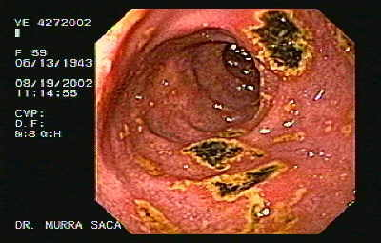
Investigation
Stool-occult bld ±
Bld –Hb
Ba meal-shows distortion of duodenal cup or show an ulcer crater.
Endoscopy - Visualize the ulcer

Slide 168
NOTE

Slide 169
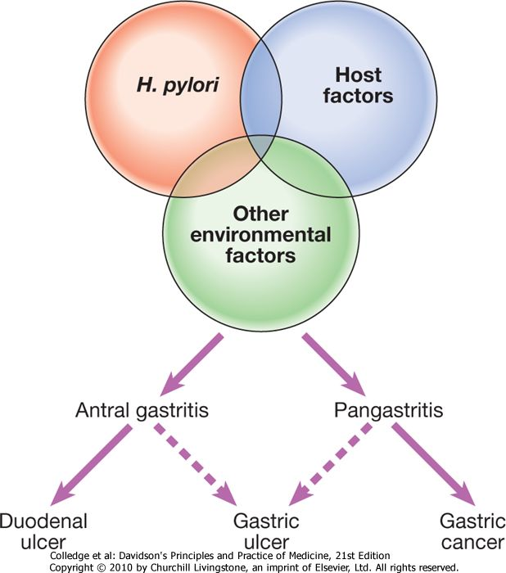
H. Pylori
Consequences of H. pylori infection

Slide 170
Methods for the diagnosis of Helicobacter pylori infection
Test | Advantages | Disadvantages
Non-invasive
Serology | Rapid office kits available | Lacks sensitivity and specificity
 | Good for population studies | Cannot differentiate current from past infection
¹³C-urea breath tests | High sensitivity and specificity | Requires expensive mass spectrometer
Faecal antigen test | Cheap, specific (> 95%) | Acceptability
Others | _ Serum amylase, Pancreatic lipase, LFTs, Urinalysis- (To R/O Other causes of pain)
Invasive (antral biopsy)
Histology | High Sensitivity and specificity | False negatives occur Takes several days to process
Rapid urease tests | Cheap, quick, specific (> 95%) | Sensitivity 85%
Microbiological culture | 'Gold standard' Defines antibiotic sensitivity | Slow and laborious Lacks sensitivity

Slide 171
Antibiotic regimens for H. pylori eradication
'First-line therapy is a proton pump inhibitor (12-hourly), clarithromycin 500 mg 12-hourly, and amoxicillin 1 g 12-hourly or metronidazole 400 mg 12-hourly, for 7 days.
This is superior to ulcer-healing drugs for duodenal ulcer healing (relative risk of ulcer persistence 0.66, 95% confidence interval 0.58-0.78).'

Slide 172
Common side-effects of H. pylori eradication therapy
Diarrhoea
30-50% of patients; usually mild but Clostridium difficile-associated colitis can occur
Flushing and vomiting when taken with alcohol (metronizadole)
Nausea, vomiting
Abdominal cramp
Headache
Rash

Slide 173
Indications for H. pylori eradication
Definite
Peptic ulcer
MALToma
H. pylori-positive dyspepsia
Not indicated
Gastro-oesophageal reflux disease
Asymptomatic
Uncertain
Family history of gastric cancer
Non-ulcer dyspepsia
Long-term NSAID users

Slide 174
Diseases Associated with Helicobacter pylori Infection
Disease | Association
Chronic gastritis | Strong causal association
Peptic ulcer disease | Strong causal association
Gastric carcinoma | Strong causal association
Gastric MALT lymphoma* | Definitive etiologic role
* MALT, mucosa-associated lymphoid tissue

Slide 175
H. PYLORI
H. pylori is a nonsporing, curvilinear gram-negative rod measuring approximately 3.5 × 0.5 μm.
H. pylori is part of a genus of bacteria that have adapted to the ecologic niche provided by gastric mucus, which is lethal to most bacteria.

Slide 176
The specialized traits that allow it to flourish include:
Motility (via flagella), allowing it to swim through viscous mucus
Elaboration of a urease, which produces ammonia and carbon dioxide from endogenous urea, thereby buffering gastric acid in the immediate vicinity of the organism
Expression of bacterial adhesins, such as BabA, which binds to the fucosylated Lewis B blood-group antigens, enhances binding to blood group O antigen bearing cells.
Expression of bacterial toxins, such as cytotoxin association gene A (CagA) and vacuolating cytotoxin gene A (VacA).

Slide 177
Difference between DU and GU
Factors | DU | GU
Incidence | -Four times more common - More common in males than females M:F 4:1 | -Less common - More common males than females M:F-3.5:1
Age | - Young patients 25-50yrs | - Affects elderly >60yrs
^{Aetiology} | H.pylori with genetic predisposition – Bld grp O Others; hypersecretion of acid pepsin, tobacco, hyperthyroidism, chronic pancreatitis, genetic factors | Associated with gastritis, bile reflux, drugs, tobacco, alcohol Normal to low acid level, hyperacidity if present is due to high serum gastrin Damage to mucus barrier is a significant factor
Pathogenesis | Common in first part of duodenum Protective gastric mucus barrier may be damaged | - Common along the lesser curvature and pyloric antrum

Slide 178
Clinical features | Episgastic pain-food-relieve pattern (Hunger pains) Night pain is common Vomiting is not common No loss of wt Tend to present with malaena more than haematemesis Have marked seasonal variation Tend to have deep tenderness in the right hypochondria No particular choice of diet Occurs more commonly in people at greater stress | Epigastric pain is worse with eating (Food-Pain pattern) No night pain Vomiting is a common feature There is significant wt loss Tend to present with haematemesis more than malaena No seasonal variation Tend to have deep tenderness in the middle of epigastrium Patients choose bland diet, devoid of fried food, curries Occurs more often in labouring groups

Slide 179
Complications
1. Haemorrhage
-If chronic, patient present with, iron deficiency anaemia.
Malaenia-stool-ocult bld-+/-
-Haemorrhage
-Fainting attacks
-General body weakness
-Coffee-ground like vomitus
-Features of shock
TX
-Resuscitate
-IVF
-Bld-GXM
-Take one hourly pulse and BP
-Transfuse-if Hb
-Surgery +/-

Slide 180
2. Gut perforation-peritonitis
-Common site of perforation on the anterior wall, where it is covered by peritoneum.
CF
-Sudden onset of severe abdominal pain.
-Patient fears to take breath
-Board like rigidly on palpation—P/A
-Bowel sounds or absent on Auscultation.
-Or silent abdomen.
TX
Surgery

Slide 181
3. Pyloric obstruction /Stenos is (GOO- Gastric Outlet Obstruction)
- This is obstruction of the Gastric outlet due to scarring.
CF
Affects appr. 5% of patients
Anorexia and nausea
Vomiting-projectile
O/E
Weight loss
Abdominal distension
Visible peristaltic movements
Ix
-- Hypochloreamic hypokalaemic Metabolic Acidosis, paradoxical aciduria
TX
-IVF
-NGT-decompress the stomach
-Surgery

Slide 182
4. Gastrojejuno colic Fistula-penetration to pancreas
5. Can turn malignant – esp. GU in less than 1% of the cases.
6. Infections - peritonitis
7. Aspiration pneumonia

Slide 183
Management

Slide 184
Management of PUD
1. Investigation
Good typical history
Barium meal, Double contrast studies – show site of ulcer
Endoscopy + Biopsy + Rapid urase test – r/o H.pylori
Feacal antigen test - r/o H.pylori
Urea breath test- r/o H.pylori
Stool-occult blood
Blood –Hb
Test acid titres
Serum gastrin
Gastric content-C/S
.

Slide 185
2. Supportive
Qiuck assessment of the patient
Pain control
Educate on diet
Avoid drugs which irritate Gastric mucosa
Stop smoking
Stop alcohol
Rest
Nutritional support - Take small frequent diets, avoid food that aggravate features.
Provide emotional support
Advice on the importance of Drug compliance.

Slide 186
3. DRUGS
(A)Helicobacter pylori Eradication Therapy.
*Common drugs used;
1. Clarithromyain
2. Metronidazole
3. Amoxicillin
4. Tetracycline
5. Proton pump inhibitors
6. Bismuth
NB
-These drugs are used in combination.
* Regimes commonly used
1. Regimes using proton pump inhibitors
2. Regimes using Bismuth compounds.

Slide 187
i) Regimes using proton pump inhibitors
Combination therapy using proton pump inhibitors and two Antibodies.
Example
Omeprazole 20mg bd or lansoprazole 30mg bd with two of the following Regimes for 10-14 days.
- Metronidazole 400mg bd
-Tetracycline 500mg bd or
- Clarithromycin 500mg bd./X10-14 days
- Amoxicillin 1gm bd
NB
Administer proton pump inhibitors before meals.
All antibiotic and Bismuth can be administered with meals.
After 2/52 of treatment CT with proton pump inhibitors X4-8 weeks

Slide 188
ii) Regimes using Bismuth compounds.
Combination of bismuth subsalicylate plus two antibiotics (tetracycline plus either metronidazole or clarithromycin), plus Proton pump inhibitor
Example
Omeprazole or Lansoprazole
+
Bismuth subsalicylate QID
+
Tetracycline 500mgs QID
Metronidazole QID
NB
Quadriple therapy enhances Eradication to above 95%.
Tripple therapy enhances eradication to over 90% e.g. Ranitidine, Bismuth Citrate, clarithromycin and Amoxyl.
NB
These regimes have different marketing Names
e.g. Helirid kit-Has clarithromycin
Pylori kit –Has Amoxyl.

Slide 189
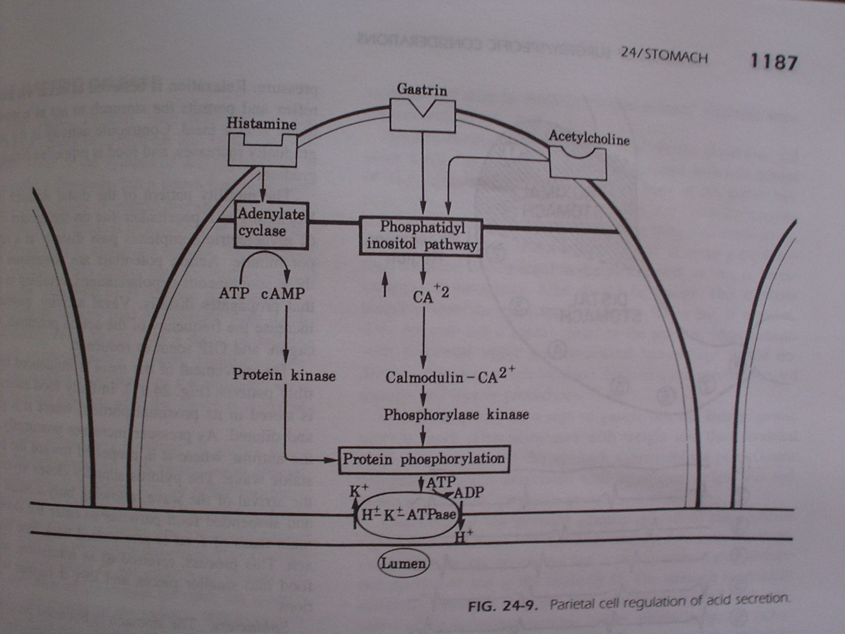
Parietal cell regulation of Gastric Acid

Slide 190
(B) Acid antisecretory Agents
1. Proton pump inhibitors
E.g. - Omeprazole 20mgs
- Lansoprazole 15-30mgs
- Pantoprazole
- Esomeprazole
- Rabeprazole - IROME – Immediate release omeprazole (PIRSEC)
(Omeprazole 40mgs + NaHCO₃ 1100mgs)
MOA
Proton pump inhibitors covalently bind the acid secreting enzyme H+ K+ AT pase or proton pump: permanently inactivating it.

Slide 191
2. H2 receptor antagonist
e.g.
Cimetidine 800mg
Ranitidine 300mg
Famotidine 40mg
Nizatidine 300mg
MOA
These agents competitively inhibit Histamine binding to the H₂ receptor on the Gastric parietal cells, thereby reducing intracellular CAMP levels and Acid secretion.

Slide 192
(C) Agents Enhancing Mucosal Defense
1. Sucralfate 1gm QID
Sucralfate is a complex salt of sucrose containing aluminium and sulfate.
MOA
The negatively charged sulfate groups bind to positively charged proteins in the ulcer bed, forming a protective barrier against acid, bile and pepsin.
Stimulates mucus and bicarbonate secretion.
Stimulates prostaglandin production.
Binds fibroblast growth factor.
NB
Should not be administered within 2 hours of other medication because it binds to some medication.
More effective in treatment of DU than GU.

Slide 193
2. Bismuth
MOA
Stimulates production of mucosal bicarbonate
Stimulates prostaglandin production.
Has a direct antibacterial action against H.pylori.
Eradicate 1/3 of the cases.
NB
Have excellent safely margins
S/E-Darkening of feaces and tongue
-Encephalopathy-in overdose

Slide 194
3. Prostaglandin analogs (misoprostol).
MOA
Stimulates mucus
Stimulate Prostaglandin production
Inhibits Acid secretion.
NB
Not very effective as a ulcer healing Agent
Used only as a prophylactic agent against NSAIDs induced ulcers.

Slide 195
4. Antacids
-Magnesium and aluminium containing antacids. Promote ulcer healing through stimulation of gastric defense not by neutralizing Acidity.
-No longer first line
-Supplement other anti ulcer therapies
S/E
-Diarrhoea
-Hypophosphataemia
-Hypermagnesaemia.

Slide 196
(4) Surgery
Indication for surgery
failure of medication therapy
prolonged medical TX-PT not willing
Non compliance to treatment
Patients with perforation
Haemorrhage
Severe Gastric atrophy
Incase of Relapse

Slide 197
CANCER OF THE STOMACH

Slide 198
GASTRIC TUMOURS

Slide 199
Gastric Tumours
Introduction
Anatomy
Pathology
Clinical features
Diagnosis
Treatment

Slide 200
Introduction
Despite a marked decline in the incidence of gastric carcinoma, stomach cancer remains the second most common cause of cancer related deaths in the world.
5-year survival rates are less than 20%, as most patients present late and are unsuitable for curative radical surgery.

Slide 201
Cancer Burden In Kenya

Slide 202
Classification of Benign Gastric Tumors
.
1. Mucosal tumors:
Non neoplastic polyps:
- Not associated with polyposis syndromes.
- Hyperplastic polyps.
- Associated with polyposis syndromes.
- Hamartomatous polyp (Peutz-Jeghers syndrome).
Neoplastic polyps:
- Fundic gland polyp.
- Adenomatous polyp.
- Gastric carcinoid.
2. Nonmucosal tumors:
Mesenchymal:
- Gastrointestinal stromal tumor (GIST).
- Glomus tumor.
Vascular:
- Haemangioma.

Slide 203
Malignant Gastric Tumors
Incidence
The risk of a person developing stomach cancer in their lifetime is about 1 in 112.
The second most common cause of cancer related deaths in the world.
Mostly affects older people and the average age at the time of diagnosis is 71 year.
It is slightly higher in men than in women.

Slide 204
Most Common types of Malignant Gastric Tumors
Adenocarcinoma (90% to 95%).
Lymphoma (4%).
Carcinoid tumor (3%).
Gastrointestinal stromal tumor (potentially malignant).

Slide 205
Risk Factors
1. Definite:
Helicobacter pylori: It causes a chronic low-level inflammation of the stomach lining and is strongly linked to the development of duodenal and gastric ulcers and stomach cancer.
Gastric lymphoma.
Previous gastric surgery.
Hereditary diffuse gastric cancer.
Hereditary non-polyposis colorectal cancer.

Slide 206
…Risk Factors
2. Probable
Ethnicity: most common in Asians.
Geography: most common in japan.
Diet: smoked food.
Pernicious anemia.
Tobacco.
Obesity.
Group A blood.
3. Possible:
Occupation: coal workers.
Low socioeconomic class.

Slide 207
Summary of Risk factors for gastric cancer
H. pylori
Smoking
Alcohol
Dietary associations Diets rich in salted, smoked or pickled foods and the consumption of nitrites and nitrates may increase cancer risk. Carcinogenic N-nitroso-compounds are formed from nitrates by the action of nitrite-reducing bacteria which colonise the achlorhydric stomach. Diets lacking fresh fruit and vegetables as well as vitamins C and A may also contribute)
Autoimmune gastritis (pernicious anaemia)
Adenomatous gastric polyps
Previous partial gastrectomy (> 20 years)
Ménétrier's disease
Hereditary diffuse gastric cancer families (HDC-1 mutations)
Familial adenomatous polyposis (FAP)

Slide 208
Premalignant Conditions
Gastric polyps.
Chronic atrophic gastritis.
Intestinal metaplasia.
Benign gastric ulcer.
Gastric remnant cancer.
Others: Ménétrier’s disease.

Slide 209
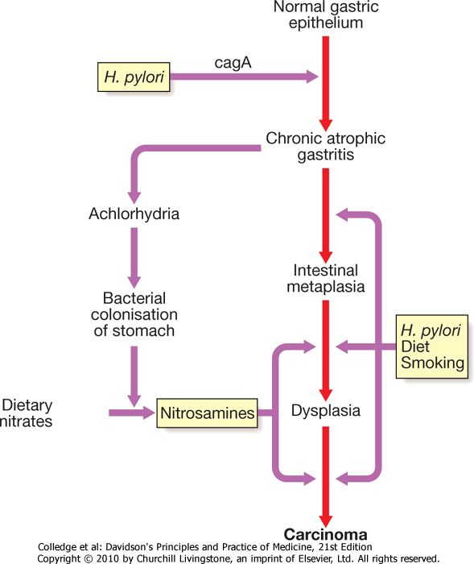
Gastric carcinogenesis: a possible mechanism

Slide 210
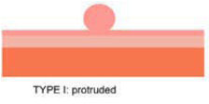
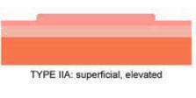
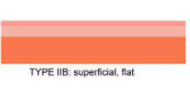
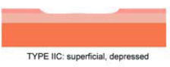

Pathological Classification
Pathological
.
Macroscopic (gross):
Early gastric cancer (Borrman’s classification)
Type 1 : Protruded.
Type 2 : Superficial.
2a: Elevated.
2b: Flat.
2c: Depressed.
Type 3: Excavated.

Slide 211
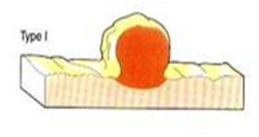
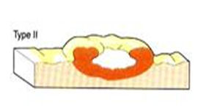
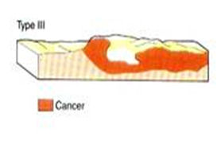
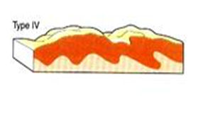
…Pathological Classification
Advanced gastric cancer (Borrman’s classification)
Polypoid (well differentiated).
Fungating.
Ulceration.
Diffusely infiltrating carcinoma (linitis plastica).
(Poor prognosis).
.

Slide 212
Microscopic (histology)
WHO classification:
.
Intestinal | Diffuse | Undifferentiated
Papillary adenocarcinoma. | Signet ring cell carcinoma. | Adenosquamous carcinoma.
 |  | Squamous carcinoma.
Tubular adenocarcinoma. | Mucinous adenocarcinoma. | Small cell carcinoma.
 |  | Others (rare).

Slide 213
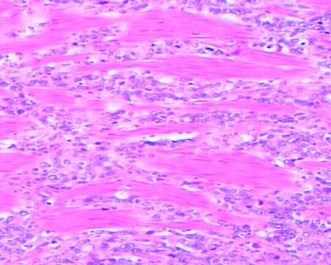
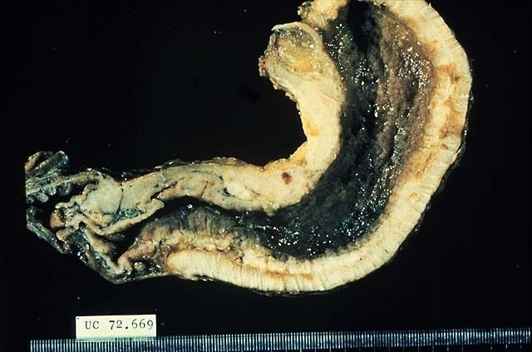

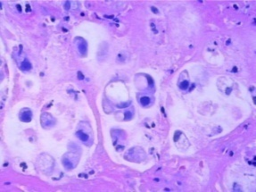
ADENOCARCINOMA GROWTH PATTERNS
LINITIS PLASTICA
Notes:
The LINITIS PLASTICA is the most SPECTACULAR, and most FEARED, of all gastric adenocarcinomas. It grows DIFFUSELY through all layers of the stomach, greatly thickening its wall, and giving the stomach a classic LEATHER BOTTLE appearance. It has a horrible prognosis.
DIFFUSE WALL THICKENING of ALL FOUR STOMACH LAYERS IS THE RULE!!!!!!!
NOT ONLY DOES IT BEHAVE LIKE WILDFIRE BUT IS ALSO POORLY DIFFERENTIATED “SIGNET” CELLS, DIFFUSELY INFILTRATIVE.

Slide 214
LINITIS PLASTICA
Diffuse submucosal infiltration by a scirrhous cancer (linitis plastica) is uncommon.
The LINITIS PLASTICA is the most SPECTACULAR, and most FEARED, of all gastric adenocarcinomas.
It grows DIFFUSELY through all layers of the stomach, greatly thickening its wall, and giving the stomach a classic LEATHER BOTTLE appearance. It has a horrible prognosis.
DIFFUSE WALL THICKENING of ALL FOUR STOMACH LAYERS IS THE RULE !!!!!!!
NOT ONLY DOES IT BEHAVE LIKE WILDFIRE BUT IS ALSO POORLY DIFFERENTIATED “SIGNET” CELLS, DIFFUSELY INFILTRATIVE

Slide 215

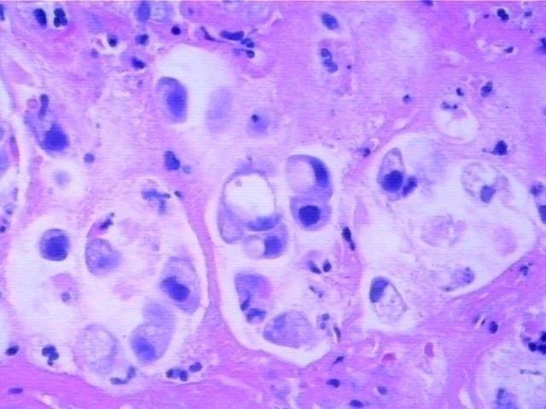
SIGNET RING
Notes:
Signet ring cells are POORLY differentiated adenocarcinoma cells, and are OFTEN seen with linitis plastica. Could those large “holes” in the cytoplasm possibly be mucicarmine positive” Answer: YES

Slide 216
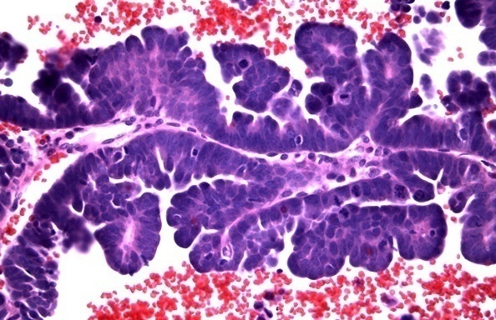
PAPILLARY
Notes:
Classical papilla! Malignant too.

Slide 217
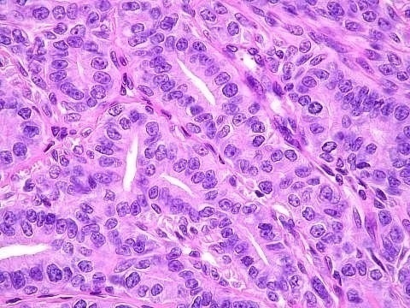
TUBULAR
Notes:
Of course, you would NEVER call this squamous.

Slide 218
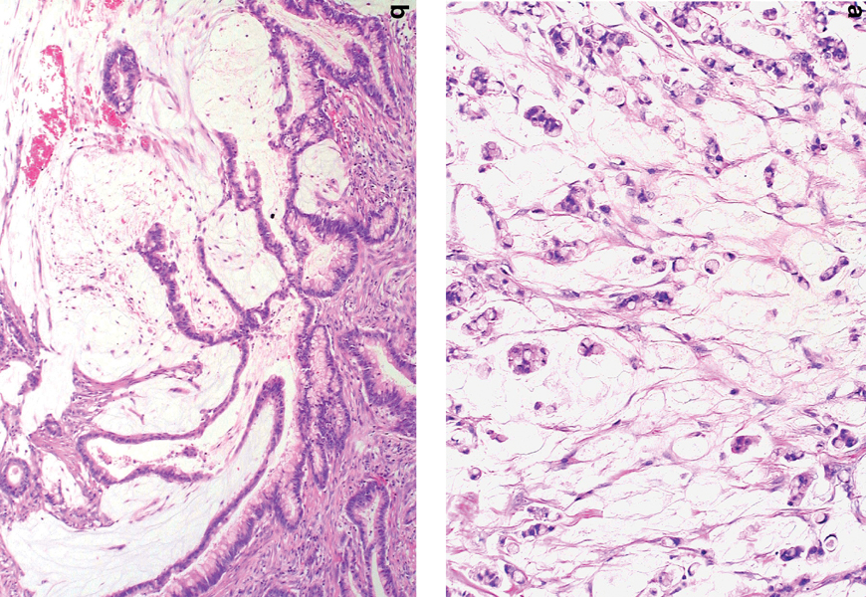
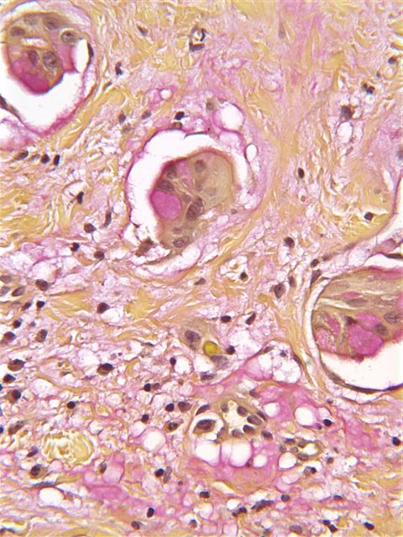
MUCINOUS
Notes:
If you thought this yucky whitish stuff was mucin, what stain would you order to prove it? Answer: Mucicarmine stain.
Is a positive muci-CARMINE stain RED (i.e., “carmine” colored)? Answer: YES

Slide 219
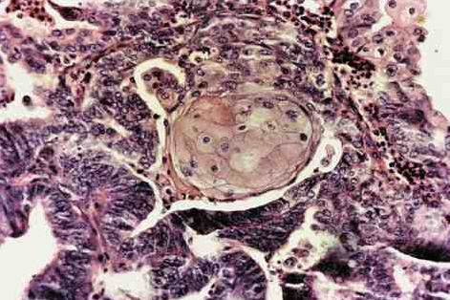
ADENOSQUAMOUS
Notes:
How can you have a squamous cell carcinoma of the stomach if the stomach has no normal squamous cells normally? Ans: SQUAMOUS METAPLASIA. The squamous component is usually NOT malignant

Slide 220
Staging Of Malignant Gastric Tumours (TNM Staging System)
T categories:
Tx: Primary tumor cannot be assessed.
T0: No evidence of primary tumor.
Tis: Carcinoma in situ.
T1: Tumor invades lamina propria or submucosa.
T2: Tumor invades muscularis propria.
T3: Tumor penetrates subserosa and serosa.
T4: Tumor invades adjacent structures.
.

Slide 221
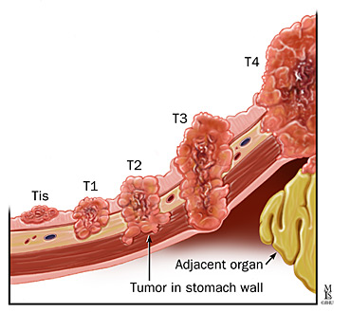
TNM Staging System
.

Slide 222
…TNM Staging System
N categories
Nx: Regional lymph nodes cannot be assessed.
No: No regional lymph nodes metastasis.
N1: Metastasis in 1 to 2 regional lymph nodes.
N2: Metastasis in 3 to 6 regional lymph nodes.
N3: Metastasis in more than 6 regional lymph nodes.
N3a: Metastasis in 7 to 15 regional lymph nodes.
N3b: Metastasis in more than 15 regional lymph nodes.

Slide 223
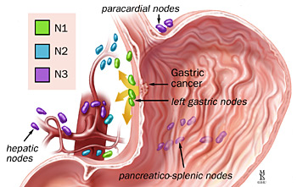
.
.

Slide 224
…TNM Staging System
.
M categories
Mx: presence of distant metastasis cannot be assessed.
M0: no distant metastasis.
M1: distant metastasis.
.

Slide 225
Diagnosis of Gastric Tumors
Clinical picture:
Common symptoms that raise the clinical suspicion of gastric tumors:
Blood in the stool.
Abdominal pain and discomfort.
Persistent nausea and/or vomiting.
Loss of appetite.
Abdominal bloating.
Changes in bowel habits.
Feeling excessively tired.
Losing weight without trying.

Slide 226
O/E
wasted
cachexic
pale
LN+
Jaundice
P/A
Palpable fixed mass in epigastrium
Hepatomegally-metastases-the liver is hard with irregular surface.
Slight tenderness in epigatrium
Ascites
Succussion splash +ve
Digital rectal exam – Rectal shelf or Bhimer’s shelf.
Bone Examination
Tenderness
Pathological #
CNS - Neurological symptoms due to cord compression

Slide 227
Occasionally, tumour spread occurs to the supraclavicular lymph nodes (Troisier's sign), umbilicus ('Sister Joseph's nodule') or ovaries (Krukenberg tumour).
Paraneoplastic phenomena, such as acanthosis nigricans, thrombophlebitis (Trousseau's sign) and dermatomyositis, occur rarely.
Metastases occur most commonly in the liver, lungs, peritoneum and bone marrow.
Due to metastasis that spread by gravity, to the true pelvis and form a shelf like structures - Rectal shelf or Bhimer’s shelf.

Slide 228
…Diagnosis of Gastric Tumors
The three common presentations according to clinical types:
Insidious type:
The most difficult type to be diagnosed.
Epigastric pain or discomfort, anorexia, nausea, weight loss, and anemia.
Obstructive type:
At the cardia : Usually increasing dysphagia.
At the pylorus : Symptoms often mimic those of peptic ulceration.
Peptic ulcerative type:
Approximately one-third of patients.

Slide 229
…Diagnosis of Gastric Tumors
Investigations:
1. Laboratory:
Complete blood count (CBC), show decreased Hb%.
Erythrocyte Sedimentation Rate (ESR) usually elevated.
Occult blood in stool is usually positive.
The liver and renal functions, not affected in early stages.
Tumor markers: CEA, CA19.9, CASO, CA72.4, P53
“the only reliable one is CA72.4”

Slide 230
…Diagnosis of Gastric Tumors
2. Endoscopy + Biopsy + Cytology
Is the GOLD STANDARD
The most accurate method of diagnosing gastric cancer currently available.
Diagnostic accuracy of 87%.
If biopsies were obtained, accuracy increases to 94%.

Slide 231
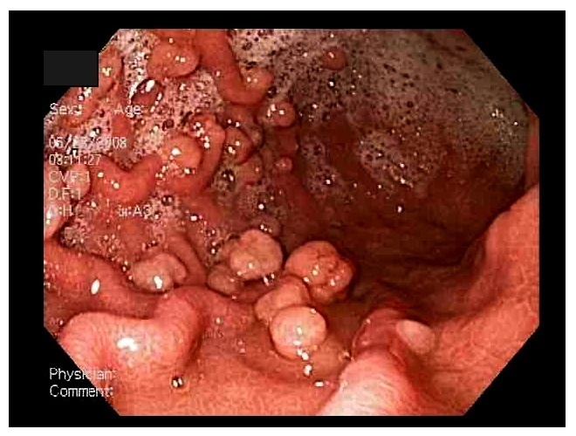
Endoscopy

Slide 232
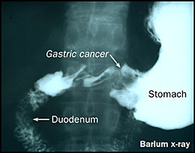
…Diagnosis of Gastric Tumors
3. Imaging:
Double Contrast Barium Meal (DCBM):
The mainstay in the diagnosis of gastric cancer .
Can differentiate early from advanced gastric cancer.

Slide 233
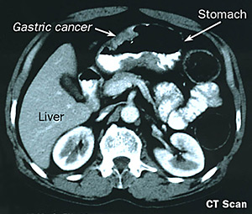
…Diagnosis of Gastric Tumors 4. Computed Tomography (CT) scans:
It’s useful for the assessment of the extra mucosal extent of the primary tumors as well as the involvement of extra gastric tissue.
Used for staging gastric
cancer with more
accuracy for advanced
disease.
Low accuracy in
proximal tumors.

Slide 234
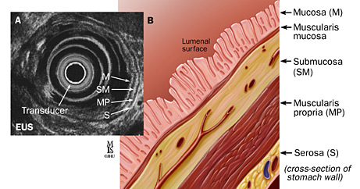
…Diagnosis of Gastric Tumors
5. Endoscopic ultrasound:
determine the depth of tumor invasion and detect local lymph node involvement.
The normal gastric wall by EUS is made up of four ultrasonographic layers of different echogenicities.
Cancer of the stomach appears at EUS as hypoechoic irregular mass.

Slide 235
…Diagnosis of Gastric Tumors
6. Laparoscopy:
Gives a unique opportunity of accurate selection of patient's subgroups on the basis of their precise clinical stage and specific prognosis, with the final goal of an individually stage adapted treatment.
Entails risk for development of port-site metastases and peritoneal seeding after laparoscopic manipulation of a tumor.
7. Peritoneal cytology:
Obtained at the time of laparoscopic staging.
Positive lavage cytology indicates microscopic peritoneal metastatic disease.
8. Chest x-ray:
Detects lung metastasis.
9. Barium meal:
10. LFT – R/O metastasis to lungs
11. Carcinoembryonic antigen (CEA) – tumour marker. Not specific. Can be raised in colonic ca.
12. Stool for occult blood

Slide 236
Screening
The greatest number of experiences with screening for early gastric cancer has been described in the Japanese literature.
In Japan the use of mass upper gastrointestinal surveys and the gastrocamera has made possible earlier detection of lesions than was possible with the usual methods in the rest of the world.
The aim of screening programs is to decrease the mortality with significantly lower incidence rates, screening is best reserved for patients at recognized high risk for gastric cancer, as patients with pernicious anemia and possibly, these who have previously undergone gastrectomy for benign disease.
.

Slide 237
Treatment of Benign Gastric Tumors
Medical: e.g.
Imatinibmesylate (Gleevec).
Only in GIST.
Used as neoadjuvant therapy.
Also used in advanced, recurrent and metastatic cases.
Surgical:
Endoscopic snare resection.
Laser ablation.
Endoscopic mucosal resection (EMR).
Wedge resection or gastrectomy.

Slide 238
Treatment of Malignant Gastric Tumors
.
The choice of treatment depends on many factors, such as location and the stage of the tumor and general state of health.
The main treatments for gastric cancer are surgery, chemotherapy and radiation therapy.
The goal of treatment is to cure cancer or to relieve symptoms.

Slide 239
Surgery
.
1. Endoscopic Mucosal Resection:
Endoscopic mucosal resection has been advocated for early gastric cancers, which are superficial and confined to the mucosa.
Without evidence of nodal or distant metastases.
For differentiated tumors that are slightly raised and less than 2 cm in diameter, or in differentiated tumors that are ulcerated and less than 1 cm in diameter.
The five-year survival rates have been reported to be as high as 95%.

Slide 240
…Surgery
.
2. Surgical resection and extent of gastrectomy:
Subtotal gastrectomy
The standard operation for gastric cancer is radical subtotal gastrectomy.
Reconstruction is usually by Billroth II gastrojejunostomy.
Roux-en-Y reconstruction is considered if a small gastric remnant is left (<20%).

Slide 241
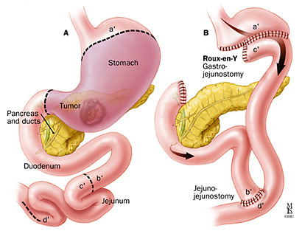
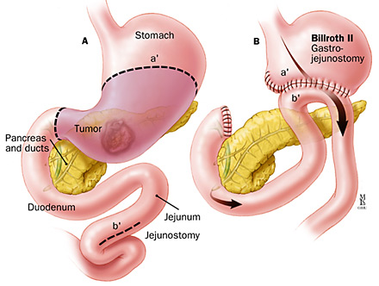
…Surgery
.
Subtotal Gastrectomy

Slide 242
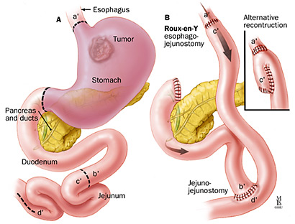
…Surgery
Total gastrectomy
The best operation for patients with proximal gastric tumors.
Total gastrectomy with Roux-en-Y esophagojejunostomy may be required.
Isoperistaltic jejunal interposition (Henley loop) between the esophagus and antrum could be considered as an alternative reconstruction.
.

Slide 243
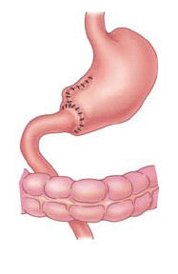
…Surgery
Reconstruction
Billroth I gastrectomy:
Reconstruction may be facilitated by mobilizing the duodenum using Kocher’s maneuver, but it carries with it the morbidity and mortality rates associated with any gastric resection.

Slide 244
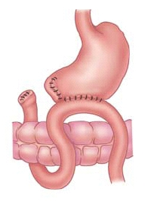
…Surgery
Reconstruction
Billroth II gastrectomy:
The use of gastrojejunal anastomosis after gastric resection could be safer and easier than the Billroth I.

Slide 245
…Surgery—Roux en Y loop
It’s the main type of reconstruction by which the continuity of GIT is restored.
Other methods of reconstruction should be discouraged because of poor functional results.
The Roux loop may be placed in either an anticolic or retrocolic position.
The Roux loop should be at least 50 cm long to avoid bile reflux oesophagitis.
.
Retro-colic roux en y loop

Slide 246
…Surgery—Lymph Node Removal
.
D1 resections: The lymph node clearance is confined to the primary group of nodes, this achieved by removal of the greater and lesser omenta with excised stomach.
D2 resection: Necessitates an additional clearance of lymph nodes around the main arteries.
D3 resection: Extends the lymph node clearance even further to include the nodes present in the porta hepatis, behind the head of pancreas, in the root of the mesentry, around the middle colic vessels and the para-aortic lymph nodes.

Slide 247
Chemotherapy
.
Gastric cancer seems to be a chemosensitive tumor.
Chemotherapy may be given as the primary (Neoadjuvant) treatment for gastric cancer that has spread to distant organs.
Also be given after surgery (Adjuvant) to prevent recurrence and may be combined with radiotherapy.

Slide 248
…Chemotherapy
Single Agent Chemotherapy:
Single agents known to have significant activity in gastric cancer include 5-flurouracil, mitomycin C, doxorubicin, nitrosoureas, cisplatin, and etoposide.
5-fluorouracil has been the most commonly used drug and, like others, has been effective against unresectable gastric cancer.
Combination Therapies for Advanced, Unresectable Gastric Cancer:
The most frequently used regimen is the combination of 5-Fluorouracil (5Fu), Adriamycin, and mitomycin C (FAM).
Another regimen is combination of etoposide, leucovorin, 5FU (ELF).

Slide 249
Radiotherapy
External beam radiation therapy is the type of therapy often used to treat gastric cancer.
Intra-operative radiation is focused on the cancer from a machine outside the body.
After surgery, radiation therapy can be used to kill very small remnants of the cancer that cannot be seen and removed during surgery.
Radiation therapy can also be used to cease the symptoms of advanced gastric cancer, such as bleeding.
.

Slide 250
Summary of ca stomach mx
A. Investigations
Complete blood count (CBC)
Tumor markers: CEA, CA19.9, CASO, CA72.4, P53
“the only reliable one is CA72.4”
Surgical resection – Total / Subtotal
Endoscopy + Biopsy + Cytology
Imaging:
Double Contrast Barium Meal (DCBM):
Computed Tomography (CT) scans
Endoscopic ultrasound
Laparoscopy
Peritoneal cytology
Chest x-ray
Barium meal
LFT – R/O metastasis to lungs
Carcinoembryonic antigen (CEA) – tumour marker. Not specific. Can be raised in colonic ca.
Stool for occult blood

Slide 251
B. Treatment
Palliative
Good nutritional care
Correct anaemia
IVF
Surgery-Gastrectomy – partial or total
Radiotherapy +/-
Chemotherapy - Cytotoxic drugs
Analgesics

Slide 252
C. Prevention
Eradication of H. pylori
Good nutrition – esp foods rich in vit A, C, E
Endoscopy screening

Slide 253
Prognosis
Poor
Pts are dead within 5 years following illness.

Slide 254
Gastric lymphoma

Slide 255
Gastric lymphoma
Primary gastric lymphoma accounts for less than 5% of all gastric malignancies.
The stomach is, however, the most common site for extranodal non-Hodgkin's lymphoma and 60% of all primary gastrointestinal lymphomas occur at this site.
Lymphoid tissue is not found in the normal stomach but lymphoid aggregates develop in the presence of H. pylori infection.
Indeed, H. pylori infection is closely associated with the development of a low-grade lymphoma ('MALToma').
EUS plays an important role in accurately staging these lesions.

Slide 256
The clinical presentation is similar to that of gastric cancer, and endoscopically the tumour appears as a polypoid or ulcerating mass.
While initial treatment of low-grade MALTomas consists of H. pylori eradication and close observation, 25% contain t(11:18) chromosomal translocations and will rarely respond.
In these cases, radiotherapy or chemotherapy is necessary.
High-grade B-cell lymphomas are treated by a combination of chemotherapy, surgery and radiotherapy.

Slide 257
The choice depends on the site and extent of tumour, the presence of comorbid illnesses, and other factors such as symptoms of bleeding and gastric outflow obstruction.
The prognosis depends on the stage at diagnosis.
Features predicting a favourable prognosis are stage I or II disease, small resectable tumours, tumours with low-grade histology, and age below 60 years.

Slide 258
Gastrointestinal stromal cell tumours (GIST)
GIST arising from the interstitial cells of Cajal are occasionally found at upper gastrointestinal endoscopy.
They are differentiated from other mesenchymal tumours by expression of the c-kit proto-oncogene, which encodes a tyrosine kinase receptor.
GISTs are usually benign and asymptomatic, but may occasionally be responsible for dyspepsia; they can also ulcerate and cause gastrointestinal bleeding.

Slide 259
Polyps

Slide 260
A variety of polyps occur.
Hyperplastic polyps and fundic cystic gland polyps are common and of no consequence.
Adenomatous polyps are rare; they have malignant potential and should be removed endoscopically.

Slide 261
Gastric Carcinoid Tumours

Slide 262
Occasionally, gastric carcinoid tumours are seen in the fundus and body in patients with long-standing pernicious anaemia

Slide 263
Gastroparesis

Slide 264
Gastroparesis is Defective gastric emptying without mechanical obstruction of the stomach or duodenum.
Can occur as a primary event, due to inherited or acquired disorders of the gastric pacemaker, or can be secondary to disorders of autonomic nerves (particularly diabetic neuropathy) or the gastroduodenal musculature (e.g. systemic sclerosis, myotonic dystrophies and amyloidosis).
Drugs such as opiates, calcium channel antagonists and those with anticholinergic activity (tricyclics, phenothiazines) can also cause gastroparesis.

Slide 265
Early satiety and recurrent vomiting are the major symptoms; abdominal fullness and a succussion splash may be present on examination.
Treatment is based upon small, frequent, low-fat meals and the use of metoclopramide and domperidone.
In severe cases nutritional failure can occur and long-term jejunostomy feeding or total parenteral nutrition is required.
Surgical insertion of a gastric pacing device has been successful in some cases but remains experimental.

Slide 266
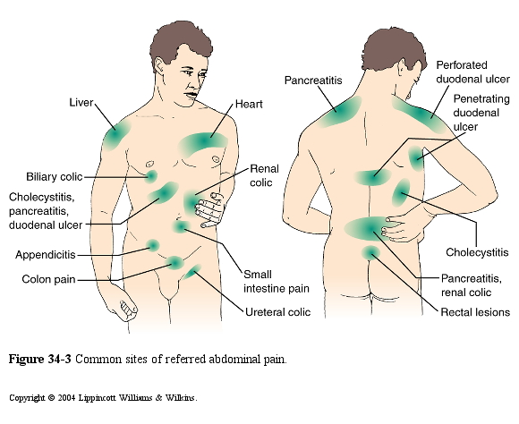
Referred Pain Locations

Slide 267
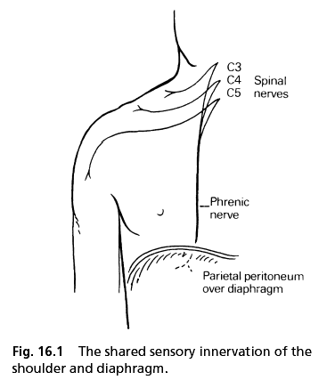

Slide 268
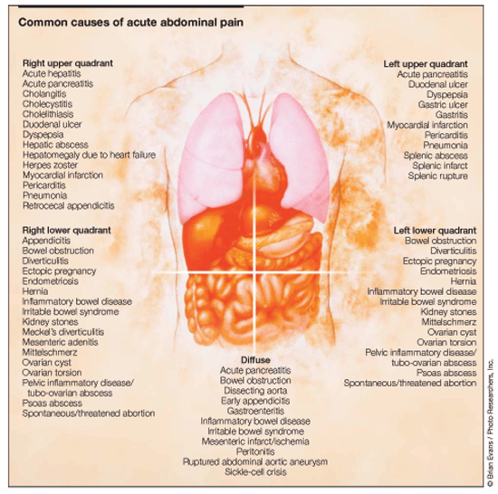

Slide 269
SMALL INTESTINE

Slide 270
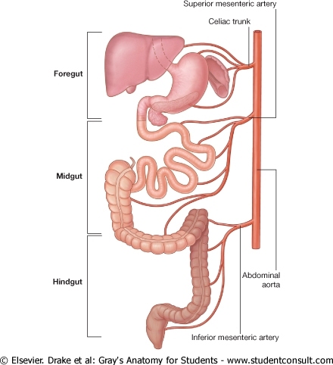

Slide 271
SMALL INTESTINE
ANATOMY AND PHYSIOLOGY
Folded long tube
Extends from the pylorus to the ileum caecal region
Divided into three parts
Duodenum
Jejunum
Ileum
Layers
Serous
Muscular
Sub mucosa
Mucosa

Slide 272
Structures which increase surface are
Villi
Microvilli
Crypts of lieberkuhn are secretory glands which secrete digestive enzymes.
Blood supply
A branch from abdominal aorta
Superior mesenteric artery
Drained by superior mesenteric vein which unite with splenic vein to form the portal vein.
Nervous supply
PSNS (parasympathetic Nervous system)
Intrinsic Nerve supply from
-Auerbach’s plexus
-Meissner’s plexus

Slide 273
Functions
-Digestion
-Absorption
Sites of absorption
1. Duodenum
-Vit ADEK
-Calcium
-Folic acid
-Fat
-Sugar
-Amino acids
2. Jejunum
-Sugar
-AA
3. Terminal ileum
Vit B12
Bile salts

Slide 274
MALABSORPTION SYNDROME
Definition
This is a condition in which there is impaired intestinal mucosal absorption of a single or multiple nutrients resulting in their excretion in stool.
Denotes disorders in which there is a disruption of digestion and nutrient absorption.

Slide 275
Aetiology
1.stomach
-Gastric surgery e.g. partial or total Gastrectomy
-Reduced acid production (Acid converts iron fe3+-fe2+
-Reduced Pepsinogen (parietal cells interfered. No conversion of pepsinogen to pepsin)
-Reduced Intrinsic factor (interfere with vit B12 absorption)
2. Pancreatic disorders
i. chronic pancreatitis
ii. Pancreatic research
iii.ca head of pancreas
iv.cystic fibrosis
-In all these disorders, there will be failure of secretion of pancreatic juice.

Slide 276
3. Hepatobiliary diseases
i. Biliary tract obstruction
ii. Hepatitis
iii. Liver cirrhosis
-These results in insufficient bile secretion into the gut hence fats cannot be digested

Slide 277
4. Small intestine diseases /conditions
i. Massive ileum resection- the absorptive surface will be reduced.
ii. Bacterial overgrowth e.g. in diverticulum
-These causes vit B12 malabsorption and also fat maldigestion.
-Feed on vitB12 and also deconjugate bile.
iii. Villi atrophy
-May occur in inflammatory disease e.g. Tropical sprue or celiac disease
iv. Infections and infestation e.g. acute gastroenteritis, Giardiasis, D. latum (Fish tapeworm). These leads to nutrient loss.
5.Lactase deficiency
This enzyme breaks down lactose into simple sugars which can be absorbed/digested.

Slide 278
6.Lymphatic vessel obstruction/blockage
-May be caused by lymphadenopathy or lymphoma.
-Hinder absorption of fats.
7. Ischemic bowel disease
This is due to:-
Mesenteric vein thrombosis
Chronic congestive cardiac failure
Mesenteric artherosclerosis
-With these conditions ischemia results thus there will be reduced bowel absorption.

Slide 279
8. Sub acute /chronic intestinal obstruction.
-these interfere with digestion.
9. Drug induced malabsorption.
-This may be brought about by:-
-Prolonged use of broad spectrum Antibiotics → destruction of the normal flora → to diarrhea.

Slide 280
CF
Abdominal distension
Diarrhoea
Steatorrhoea
growth failure
weight loss
weakness and easy fatigability

Slide 281
O/E
Oedema - Due to hypoproteinaemia
mixed type of anaemia
finger clubbing
Glossitis and cheilosis - folate and iron deficiency
Bleeding tenderness -Vit. K
Tetany- calcium
Rickets - vit. D
Osteomyelitis
Peripheral neuropathy
Ammenorrhoea - due to Hypoproteinaemia
- Other features are those of underlying dz.

Slide 282
Investigations
1. Stool-O/C
2. Stool to assess fat contents
- normal Feacal fat excretion should be <7gms/day
3. Carbohydrates absorption test
GTT-Glucose Tolerance test
Fast the patient overnight, then in the morning a blood sample is taken to determine fasting blood sugar glucose level.
Then 50gms of glucose dissolved in 250mls of H2O is given to the patient orally and then samples of blood sugars are collected ½ hourly for at least 2 hours.
The glucose level is estimated then charted.

Slide 283
4. Blood for serum protein.
Disease that lower serum proteins.
Malabsorption
Protein loosing enteropathy
Renal disease
Hepatic disease
5. Vitamin B12 absorption test.
This is done using schilling test.
-Radioactive vit. B12 is given by mouth and urine collected for 24 hours.
-A normal individual will excrete at least 10 % of the original dose over this period.
NB
A pt with pernicious anaemia will excrete less than 5%.

Slide 284
Other investigations
Blood for Electrolyte level e.g. ca²⁺⁺, K⁺
Bone x-ray - Oesteo-malacia
Blood –FHG-shows the type of anaemia
Ba meal –shows dilated lumen, with loss of the feather pattern
Biopsy-show evidence of atrophy.

Slide 285
Summary
1.Steatorrhoea (Bulky ,light colored stools)
-Lab-increased feacal fat.
-decreased serum cholesterol.
2. Diarrhoea (increased feacal water)
Lab-increased feacal fat
-positive bile salt breath test.
Deficiency nutrient -Fatty acids
-Bile salts.
3. Weight loss/malnutrition (muscle wasting)
Weakness, fatigue, abdominal distension.
Lab- Increased feacal fat and nitrogen.
-Decreased glucose and xylose absorption.
Deficiency nutrient – calories (fat, protein and carbohydrates.)

Slide 286
4. Iron deficiency anaemia
Lab -Hypo chromic anaemia
-low iron
Deficiency nutrient-iron
5. Megaloplastic anaemia.
-Lab-macrocytosis
-Decreased serum B12 and cell folate.
Deficiency nutrient-vit. B12
-folate
6. Paraesthesia/tetany/positive Trousseaus and chvostek signs.
-Lab-decreased serum -calcium
-magnesium
-potassium
-Deficiency nutrient-Calcium
-vit D
-magnesium
-potassium

Slide 287
7. Bone pain/pathological #s/skeletal deformity
Investigation results
Osteoporosis on X-ray
Oesteomalacia on Biopsy
Deficiency nutrient-calcium
-protein
8. Bleeding Tendency (Ecchymosis, melena, heamaturia)
Lab-prolonged prothrombin time.
Deficiency nutrient –vitamin K.
9. Oedema
Lab-Decreased serum albumin
-Increased faecal loss of antitrypsin (ant protease).
Deficiency nutrient-protein (or protein losing Enteropathy)

Slide 288
10. Nocturia/Abdominal distension.
Investigation
Increased small bowel fluid on X-ray
Deficiency or malabsorption of Water
11. Milk intolerance (cramps , bloating , diarrhoea)
-Lab Flat lactose tolerance test.
-Decreased mucosal lactase levels.
-Deficiency nutrient/malabsorption of:-
-lactose

Slide 289
TX
1. IVF
2. Treat
-Any malnutrition
-Bleeding Tendency
-Anaemia –Treat
-Hypocalcaemia-calciumgluconate
-Prolonged A/b therapy –stop therapy
-Lack of vitamins –maltivitamins-parenteral e.g. parenterovite IV
-Vitamin D deficiency-Vitamin D
3. Identity and treat the cause.

Slide 290
Referred Pain Locations

Slide 291
COELIAC DISEASE

Slide 292
COELIAC DISEASE
This is a disorder characteristic by an abnormal mucosa in the small intestines induced by ingestion of GLUTEN containing foods e.g. barley, wheat.
It is associated with malabsorption.
Aetiology
Caused by a polypeptide gluten in wheat, barley etc.

Slide 293
Pathophysiology – SUMMARY (OPTIONAL)
Gluten and its break down products i.e. Gliadin are toxic to the intestinal mucosa.
They cause damage to intestinal mucosa and eventually there will be blunting or loss of vili and also the crypts of lueberkuhn.
This will cause an increased reduction in absorption.

Slide 294
Pathophysiology of coeliac disease.
After being taken up by epithelial cells, gluten peptides are deamidated by the enzyme tissue transglutaminase in the subepithelial layer.
They are then able to fit the antigen-binding motif on HLA-DQ2-positive antigen-presenting cells.
Recognition by CD4+ T cells triggers a Th₁ (T helper cell) immune response with generation of pro-inflammatory cytokines (IL-1, IFN-γ and TNF-α).
Lymphocytes infiltrate the lamina propria, and increased intraepithelial lymphocytes (IEL), crypt hyperplasia and villous atrophy ensue.

Slide 295
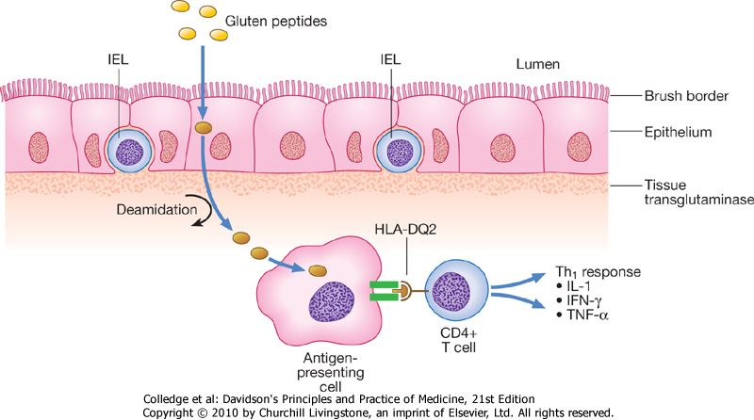

Slide 296
CF
Manifest as early as 6/12 -2 years
In adults 20-50 years
Failure to thrive
weight loss
Diarrhoea
Anorexia
Irritability
O/E
Finger clubbing
-Other features are those of malabsorption.

Slide 297
DX
Evidence of malabsoption
Clinical improvement if gluten free diet is given.
Biopsy-There is flattening of villi.
TX
1.Gluten free diet
-Clinical symptoms begin to subside.
-If no clinical improvement the dx is wrong
2. Replace lost nutrients
3. Steroids-if the pt is not improving.

Slide 298
CROHN’S DISEASE
This is chronic relapsing granulomatous inflammatory disease of the GIT, Commonly affecting the terminal ileum.
Many other areas of the GIT may be affected.
Aetology
Idiopathic.
It is thought to be associated with Ab + Ag Rxn.
Any age can be affected – commonly-btw-20-40years.
Both sexes are equally affected.

Slide 299
Pathophysiology
The mucosa displays features of inflammation i.e. engorged, oedematous.
As a result of engorgement and oedema, the lumen of the small intestine becomes narrow →Obstruction of intestinal flow.
These changes appear in patches.
In the affected areas LN may be seen.
The affected mucosa also may be ulcerated.
With time fissures form. May progress deeper→fistulae formation. These Fistulae may extend to involve the surrounding organs.
As a result of fistulae formation there is secondary bacterial infections.

Slide 300
CF
Abdominal pain - colicky in nature.
Diarrhoea +/- stool-Blood stained.
Fever
Other features are those of malabsorption.
O/E
Pale
Finger clubbing
P/A
Tenderness
Palpable masses

Slide 301
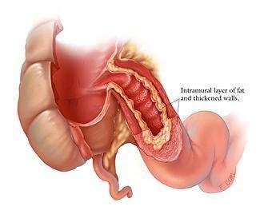

Slide 302
DDX
Salphingitis
Acute pelvic inflammatory disease
Acute appendicitis
Intestinal amoebiasis
Ca colon
Ulcerative colitis

Slide 303
Investigations
Stool –microscopy- pus cells
- rbc
2. Bld –FG-show features of anaemia
3. Ba meal and follow through
-Shows thickened gut wall with narrowing of the lumen i.e. string sign.
4.Ba enema – since colon may also be affected.

Slide 304
Crohn's Disease Treatment
The goals of treatment of Crohn's disease are to reduce the underlying inflammation, which then relieves symptoms, prevents complications, and maintains good nutrition.
Medications used in reducing inflammation in Crohn's disease include;
anti-inflammatory drugs
corticosteroids
immunosuppressants
antibiotics.

Slide 305
1. Aspirinlike anti-inflammatory drugs reduce the inflammation. These drugs are used to prevent flares in people with mild Crohn's disease. E.g.
Mesalamine (Asacol, Rowasa, Canasa) tends to work best in Crohn's disease affecting mainly the colon and to some extent the small intestine. Oral and rectal suppository forms are available. Long-term use may delay relapse of the disease.
Sulfasalazine (Azulfidine) tends to work best in Crohn's disease affecting mainly the colon. It does not work well in the small intestine. Long-term use generally does not delay relapse. People on sulfasalazine should take folic acid.
2. Corticosteroids reduce inflammation and suppress the immune system. They can be used in the short term only. Corticosteroids are indicated in persons with severe systemic symptoms (for example, fever, nausea, weight loss) and in those who do not respond to anti-inflammatory agents.e.g.
Prednisone (Deltasone, Orasone, Meticorten)
Budesonide (Entocort )

Slide 306
3. Antibiotics reduce inflammation indirectly by reducing infection. E.g.
Metronidazole (Flagyl), besides acting as an antibiotic, has immunosuppressive and anti-inflammatory properties.
Ciprofloxacin (Cipro)
Cephalosporin, ampicillin, tetracycline, sulfonamide, and others
4. Immunosuppressants suppress the immune system. Some are more effective than steroids, while others have longer duration of effect. E.g.
Infliximab (Remicade) is a monoclonal antibody that acts against tumor necrosis factor alpha, a natural product of the immune system that promotes inflammation. Infliximab is used to treat moderately severe-to-severe Crohn's disease that does not get better with other medications. When given as an intravenous infusion, its effects last for approximately 12 weeks. Repeated doses may be required.
Azathioprine (Imuran) inhibits the immune response that causes inflammation.

Slide 307
complications
The intestinal complications of Crohn's disease include the following:
Intestinal obstruction
Fistulas
Abscess
Hemorrhage (bleeding) - Unusual in Crohn's disease
Malabsorption - Results in diarrhea and nutritional deficiencies
Acute regional enteritis
Carcinoma - Colonic disease increases risk of colon cancer

Slide 308
THE LARGE INTESTINE

Slide 309
THE LARGE INTESTINE
Divided into three:-
1. Caecum
2. Colon
3. Rectum
Functions
Absorption of water and Electrolytes
Putrefaction of undigested protein releasing products e.g. methane, hydrogen, sulphate, ammonia and carbon dioxide.

Slide 310
ULCERATIVE COLITIS

Slide 311
ULCERATIVE COLITIS
This is a non specific chronic inflammatory disease of the colon, generally following a prolonged course with alternating periods of remission and exacerbation.
Aetiology
Unknown

Slide 312
PF
1. Genetic factors-Evidence in twins.
2. Autoimmunity –Antibodies have been identified in the body which attack the colon.
3. Psychological disturbances-provoke attack.
e.g. undue dependence on others have been seen in pts with ulcerative colitis.
4. Recurrent infection of the colon
5. Peak incidences-20—40years
6. Males and females are equally affected.

Slide 313
Pathology
Inflammatory changes are seen in the all mucosa. As a result the all mucosa become oedematous, hyperaemic and may bleed.
Later ulcerations form. As the disease progress there is
-Loss of tissues
- Loss of protein
-Loss of blood
Eventually in chronic state there is fibrous tissue deposition. Because of fibrosis →narrow lumen.
Because of this the function of the large intestines becomes impaired.

Slide 314
CF
Diarrhoea-blood
Tenesmus
Abdominal pain
O/E
Wasted
Dehydrated
Pale
Febrile
Finger clubbing
P/A
tenderness over colonic region
Evidence of vitamin deficiency.

Slide 315
Investigation
Blood-FHG-high wbc,low Hb,high ESR
Ba enema-+/- rugged ulceration with narrowed colon.
Sigmoidoscopy –The mucosa is engorged, Granulomas and hyperaemic with bleeding spots.
Rectal Biopsy confirms dx.
Investigate for malabsorption
DX is confirmed by –Biopsy

Slide 316
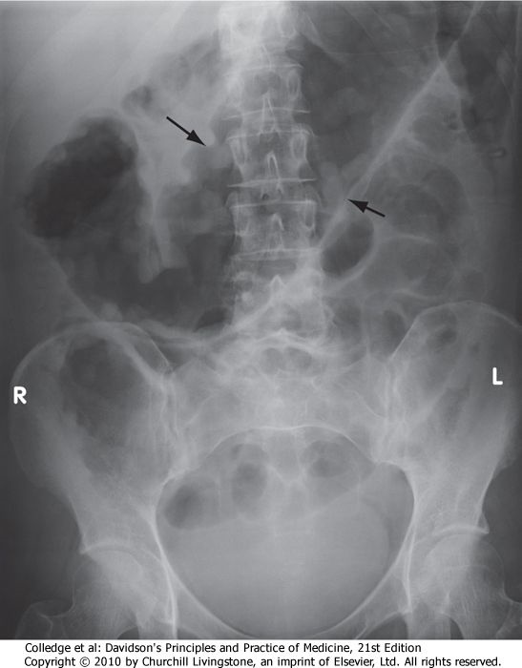
Plain abdominal X-ray showing a grossly dilated colon due to severe ulcerative colitis. There is also marked mucosal oedema and 'thumb-printing' (arrows).

Slide 317
TX
-No specific TX
1. General measures.
Give low residual diet –Not rich in roughage.
Replace lost nutrients
Correct fluid and Electrolyte loss by giving IVF.
2. Drugs
i. Anti inflammatory drugs
Steroids e.g. prednisolone 60mg/day in divided doses and Tail it of to 10 mg/day in divided doses.
ii. Antibiotics
If there is evidence of infection i.e. secondary bacterial infection.
iii. Sulphasalazine 2-4 mgs/day till the symptoms subsides. This drug is thought to stop Relapses.
3. Surgery may be done if the patient has complications.

Slide 318
Complications
Haemorrhage
Malabsorption-→malnutrition
Fistula formation
Gut formation
Colonic stricture formation.
Ca colon

Slide 319
Factors considered for disease severity assessment in ulcerative colitis
 | Mild | Severe
Daily bowel frequency | < 4 | > 6
Blood in stools | +/- | +++
Stool volume | < 200 g/24 hrs | > 400 g/24 hrs
Pulse | < 90 bpm | > 90 bpm
Temperature | Normal | > 37.8°C, 2 days out of 4
Sigmoidoscopy | Normal or granular mucosa | Blood in lumen
Abdominal X-ray | Normal | Dilated bowel and/or mucosal islands
Haemoglobin | Normal | < 100 g/L (< 10 g/dL)
ESR | Normal | > 30 mm/hr
Serum albumin | > 35 g/L (> 3.5 g/dL) | < 30 g/L (< 3 g/dL)

Slide 320
SUMMARY OF IBS

Slide 321
Features of irritable bowel syndrome
Colicky abdominal pain
Altered bowel habit
Abdominal distension
Rectal mucus
Feeling of incomplete defecation

Slide 322
Features supporting a diagnosis of IBS
Symptoms > 6 months
Frequent consultations for non-GI problems
Previous medically unexplained symptoms
Stress worsens symptoms
Alarm features
Age > 50 years; male gender
Weight loss
Nocturnal symptoms
Family history of colon cancer
Anaemia
Rectal bleeding

Slide 323
Irritable Bowel Syndrome: Treatment
Patient Counseling and Dietary Alterations
Stool-Bulking Agents
Antispasmodics
Antidiarrheal Agents
Antidepressant Drugs
Antiflatulence Therapy
Serotonin Receptor Agonist and Antagonists
Chloride Channel Activators

Slide 324


Slide 325
Possible Drugs for a Dominant Symptom in IBS
Symptom | Drug | Dose
Diarrhea | Loperamide | 2–4 mg when necessary/maximum 12 g/d
 | Cholestyramine resin | 4 g with meals
 | Alosetron | 0.5–1 mg bid (for severe IBS, women)
Constipation | Psyllium husk | 3–4 g bid with meals, then adjust
 | Methylcellulose | 2 g bid with meals, then adjust
 | Calcium polycarbophil | 1 g qd to qid
 | Lactulose syrup | 10–20 g bid
 | 70% sorbitol | 15 mL bid
 | Polyethylene glycol 3350 | 17 g in 250 mL water qd
 | Lubiprostone (Amitiza) | 24 mg bid
 | Magnesium hydroxide | 30–60 mL qd
Abdominal pain | Smooth-muscle relaxant | qd to qid ac
 | Tricyclic antidepressants | Start 25–50 mg hs, then adjust
 | Selective serotonin reuptake inhibitors | Begin small dose, increase as needed

Slide 326
Differences between Ulcerative Colitis and Crohn's Disease
 | Ulcerative Colitis | Crohn's Disease
Clinical features
Rectal involvement | Over 90% | Rectum spared in > 50%
Distribution of lesions | Continuous | Skip lesions
Mucosal appearance | Friable, purulent, diffusely involved | Aphthous, linear ulcers with cobblestoning
Associated ileal disease | 10%, mild, terminal ileal inflammation | 50% have combined ileal and colonic involvement
Perianal abscess, fistulas | Rare | Common
Intestinal strictures and obstruction | Not seen | Common
Intestinal fistulas | Not seen | Common

Slide 327
Fissures (radiologic) | Not seen | Common
Intestinal perforation | Rare | Rare
Intestinal hemorrhage (severe) | Common | Rare
Toxic megacolon | Rare | Very rare
Extraintestinal manifestations
Sclerosing pericholangitis | Common | Rare
Uveitis or arthritis | Common | Common
Pyoderma gangrenosum | Rare | Not seen

Slide 328
Pathologic features
Depth of inflammation | Mucosal (submucosal rarely) | Transmural
Creeping mesenteric fat | Not seen | Common
Fibrous thickening of wall | Not seen | Common ("lead pipe")
Crypt abscesses | Common | Common
Pseudopolyps | Common | Common
Granulomas (epithelioid, noncaseating) | Not seen | Common
Fissures (microscopic) | Not seen | Common
Dysplasia | Common | Rare
Carcinoma | 10% | Rare

Slide 329

aphthoid ulcers typical of Crohn's disease

Slide 330

cobblestone appearance

Slide 331

Common patterns of disease distribution in inflammatory bowel disease.

Slide 332

Systemic complications of inflammatory bowel disease.

Slide 333
NEOPLASMS OF LAGRE INTESTINES

Slide 334
NEOPLASMS OF LAGRE INTESTINES
May be;
1. Benign -lipomas
-Leiomyomas
-Polyps
-polyposis syndromes
2. Malignant – colorectal carcinoma

Slide 335
Polyps may be neoplastic or non-neoplastic.
The latter include hamartomas, metaplastic ('hyperplastic') polyps and inflammatory polyps.
These have no malignant potential.
Polyps may be single or multiple and vary from a few millimetres to several centimetres in size.

Slide 336
Colorectal adenomas are extremely common
Histologically, they are classified as either tubular, villous or tubulovillous, according to the glandular architecture.
Adenomas are usually asymptomatic and discovered incidentally.
Occasionally, they cause bleeding and anaemia.
Villous adenomas sometimes secrete large amounts of mucus, causing diarrhoea and hypokalaemia.

Slide 337
Polyposis syndromes are classified by histopathology.
Neoplastic
Familial adenomatous polyposis
Non-neoplastic
Peutz-Jeghers syndrome
Juvenile polyposis
Cronkhite-Canada syndrome
Cowden's disease
It should be noted that, while the hamartomatous polyps in Peutz-Jeghers syndrome and juvenile polyposis are not themselves neoplastic, these disorders are associated with an increased risk of certain malignancies, e.g. breast, colon, ovary and thyroid.

Slide 338
Risk factors for malignant change in colonic polyps
Large size (> 2 cm)
Villous architecture
Multiple polyps
Dysplasia

Slide 339

Familial adenomatous polyposis. There are hundreds of adenomatous polyps throughout the colon.

Slide 340
Peutz-Jeghers syndrome
Diagnosis requires two of the following:
small bowel polyposis
mucocutaneous pigmentation
a family history suggesting autosomal dominant inheritance.

Slide 341

Peutz-Jeghers syndrome. Typical lip pigmentation.

Slide 342
Juvenile polyposis (JPS)
In this condition, tens to hundreds of mucus-filled hamartomatous polyps are found in the colorectum.
One-third of cases are inherited in an autosomal dominant manner and up to 20% of patients develop colorectal cancer before the age of 40.
The criteria for diagnosis are:
10 or more colonic juvenile polyps
juvenile polyps elsewhere in the gut, or
any number of polyps in those with a family history.
Germline mutations in the tumour suppressor gene SMAD4 are often found, as are PTEN mutations.
Colonoscopy with polypectomy should be performed every 1-3 years and colectomy considered for extensive involvement.

Slide 343
COLORECTAL CARCINOMA

Slide 344


Slide 345
COLORESTAL CARCINOMA
Definition
This is a malignant tumour of the colon + rectum.
This is the most common site of malignancy in the GIT.

Slide 346
PF
A. Risk Factors You Can not Control
1. Intestinal polyps-Have been observed to later turn malignant.
2. inflammatory bowel disease – Crohns disease and Ulcerative colitis - in long standing cases above 10 years may turn malignant.
3. Ingestion of carcinogens
-Intake of refined food which is usually rich in CHO with low roughage content are thought to cause an alteration in normal flora, with subsequent delay in degradation of bile salts or products of proteins and fat. Some of the components that need to be broken down are thought to be carcinogenic.
NB. white races are mostly affected than blocks.
4. Ages – Older than 50 years
5. Family history of colorectal cancer
6. History of ovarian or breast cancer
NB - Sex distribution –Equal.

Slide 347
B. Risk Factors You Can Control
Some factors that raise the risk of colorectal cancer are within your control e.g:
Diet high in red, processed, or heavily cooked meats
Being overweight (excess fat around the waist)
Exercising too little
Smoking or drinking alcohol

Slide 348


Slide 349

Pathology
The tumour presents as a polypoid mass projecting towards the lumen and ulcerations .Occasionally it may extend around the bowel causing a ring like stricture. Perforation may occur at the site of tumour→peritonitis, abscess formation or fistula.

Slide 350
NB. Colorectal cancers often begin as polyps – (benign growths on the surface of the colon).
The two most common types of intestinal polyps are adenomas and hyperplastic polyps.
They develop when there are errors in the way cells grow and repair the lining of the colon.
Most polyps remain benign, but some have the potential to turn cancerous.
Removing them early prevents colorectal cancer.

Slide 351
Spread
May spread
Direct to adjacent structures e.g. bladder, uterus.
Via lymphatic to surround LN
Blood stream to distant organs e.g. liver and other organs of the body.
Transcolonic to pouch of Douglas
-Ovaries

Slide 352
Clinical Features
Change in bowel habits characterized by constipation followed by diarrhoea.
Stool –blood stained.
lower abdominal pain/discomfort
Calibre of the stool will be diminished due to narrowing of the lumen in the part affected.
Anorexia and weight loss.
O/E
1. Cachexic
2. Pale
3. Jaundice +/-
P/A
Palpable mass, lower abdomen +/-
Nodular hepatomegaly
P/R
A mass may be felt
Examining digit-blood stained.

Slide 353


Slide 354


Slide 355



Adenoma carcinoma sequence

Slide 356
Complications
Haemorrhage -iron deficiency anaemia
Perforation
Intestinal obstruction
Fistulae formation with adjacent organs.

Slide 357

Investigation
Blood-FHG-Hb
CXR-R/O metastasis to lungs
Blood –LFT
Ba enema –show a filling defect
-stricture

Slide 358

5. Colonoscopy with biopsy is done.
-You will be able to see the tumour.
-Histological studies confirm diagnosis.

Slide 359
NB
There is now an alternative to colonoscopy that uses CT scan images to construct a 3-D model of your colon, Called virtual colonoscopy, the procedure can reveal polyps or other abnormalities without actually inserting a camera inside your body. The main disadvantage is that if polyps are found, a real colonoscopy will still be needed to remove and evaluate them.

Slide 360

Virtual Colonoscopy

Slide 361
Staging Colorectal Cancer
If cancer is detected, it will be "staged," a process of finding out how far the cancer has spread. Tumor size may not correlate with the stage of cancer. Staging also enables your doctor to determine what type of treatment you will receive.
Stage 0 – carcinoma in situ
Stage I – Cancer has not spread beyond the inside of the colon or rectum
Stage II – Cancer has spread into the muscle layer of the colon or rectum
Stage III - Cancer has spread to one or more lymph nodes in the area
Stage IV – Cancer has spread to other parts of the body, such as the liver, lung, or bones. This stage does NOT depend on how deep the tumor has penetrated or if the disease has spread to the lymph nodes near the tumor.

Slide 362


Slide 363
Treatment
Supportive
-Correct anaemia
-Treat any infection-Antibiotics
-surgery may be done in early dx
-radiotherapy /chemotherapy may be tried.
Prognosis
-Very poor
-1 in 5 of patients live up to 5 years.

Slide 364
NB. Colorectal Cancer Surgery
In all but the last stage of colorectal cancer, the usual treatment is surgery to remove the tumor and surrounding tissue.
In the case of larger tumors, it may be necessary to take out an entire section of the colon and/or rectum.
The good news is that surgery has a very high cure rate in the early stages.
If the cancer has spread to the liver, lungs, or other organs, surgery is not likely to offer a cure - but removing the additional tumors, when possible, may reduce symptoms.

